Slide 1
W22. Protein-Protein Interactions
February 2020
Lukasz Salwinski
lukasz@mbi.ucla.edu
Boyer Hall 205
Notes:
Title

Slide 2
Workshop Overview
Day I
Day II
Day III
Interaction Data
Processing
Introduction
Cytoscape
presentation
hands on
hands on
Experimental Methods
Experimental strategies overview
Experiment uncertainties
Interaction types
Ambiguous protein identification
Database Record Contents
Record structure
Controlled vocabularies
Record transformations
Protein Interaction Resources
Primary Databases
Integrators
Database Record Formats
PSI-MI Standards
BioGRID
Cytoscape/SIF
Parsing XML Files
Python lxml toolkit
PSI-MI MIF Format
Record structure
Compact vs expanded form
SIF (Cytoscape) Format
MIF to SIF conversion
Interaction Networks
Record structure
Compact vs expanded form
Cytoscape Overview
Installation
Basic features
Apps/Plugins overview
Loading Interaction Data
Local files
Public resources
Basic Network Visualization
Expression data
Functional enrichment
NOTE
Working knowledge of Python required. The day can be skipped by non-programmers.
Notes:
Title

Slide 3
Protein-Protein Interactions
Introduction
May 2019
Lukasz Salwinski
lukasz@mbi.ucla.edu
Boyer Hall 205
Notes:
Title

Slide 4
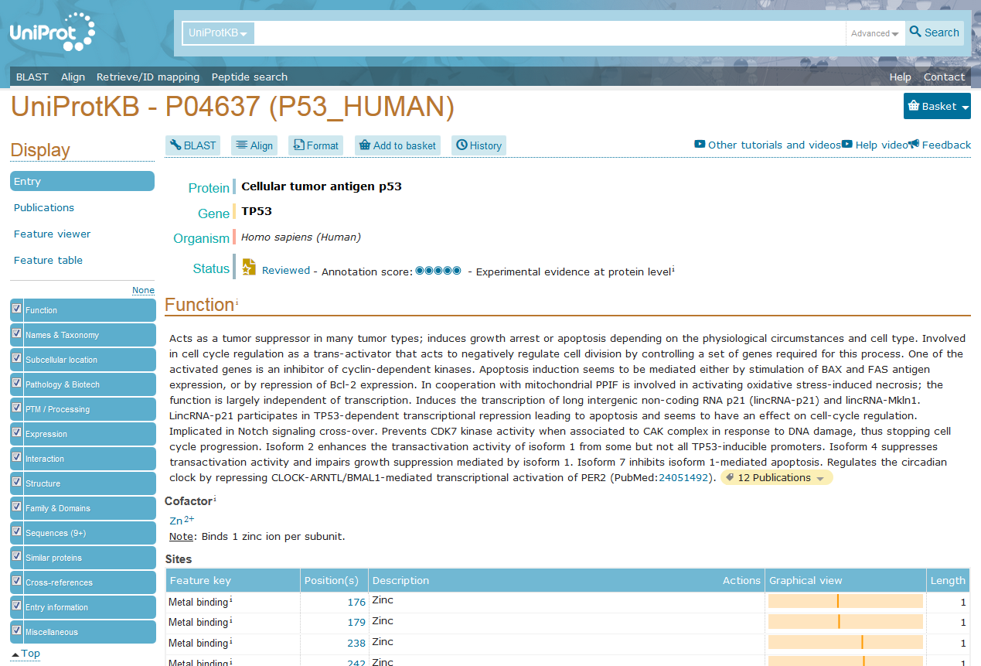
Molecular Interactions
Why do we care ?
Function
What does a protein do in a cell ?
What happens when a protein is missing ?
What happens when a protein is altered ?
https://www.uniprot.org/uniprot/P04637
Notes:
Title

Slide 5
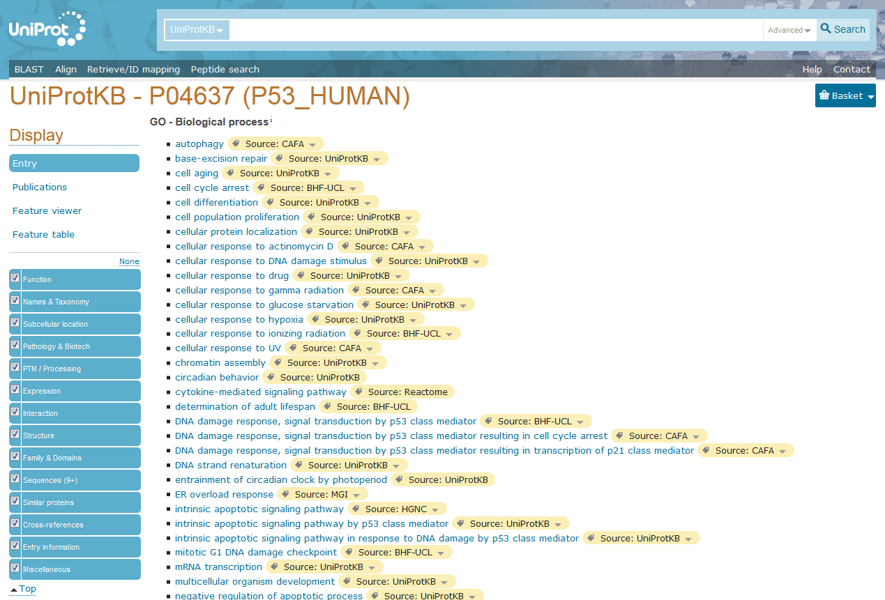
Molecular Interactions
Why do we care ?
Function
What does a protein do in a cell ?
What happens when a protein is missing ?
What happens when a protein is altered ?
Gene Ontology Annotation
Computer-readable description of function
Three complementary sections
Biological process
Molecular function
Cellular localization
Notes:
Title

Slide 6
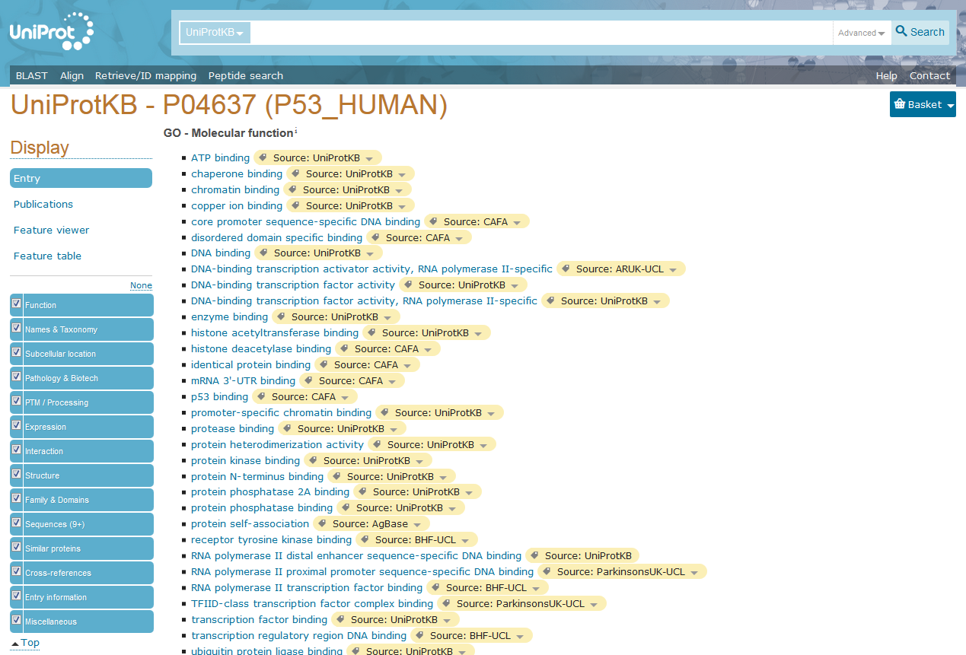
Molecular Interactions
Why do we care ?
Function
What does a protein do in a cell ?
What happens when a protein is missing ?
What happens when a protein is altered ?
Gene Ontology Annotation
Computer-readable description of function
Three complementary sections
Biological process
Molecular function
Cellular localization
Protein Function
is executed through Molecular Interactions
Notes:
Title

Slide 7
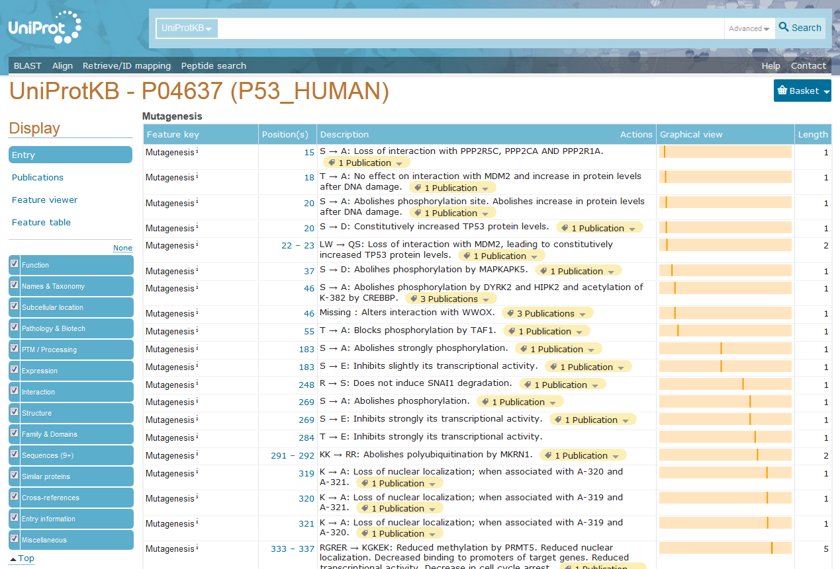
Molecular Interactions
Why do we care ?
Function
What does a protein do in a cell ?
What happens when a protein is missing ?
What happens when a protein is altered ?
Gene Ontology Annotation
Computer-readable description of function
Three complementary sections
Biological process
Molecular function
Cellular localization
Protein mutations
may modulate molecular interactions

Slide 8
Molecular Interactions
Mutation/Disease Correlation
Folding/Stability
Proxy
Same Set of Genes
Sahni et al. Cell 161:647-660(2015); PMID: 25910212
Notes:
High throughput study suggests that disease-related mutations affect patterns of P-P and P-DNA interactions with less effect on P stability. Potential bias – disease & non-disease variants for the same genes - it is possible mutations in other genes do have the same effect on interactions but without correlation with disease.

Slide 9
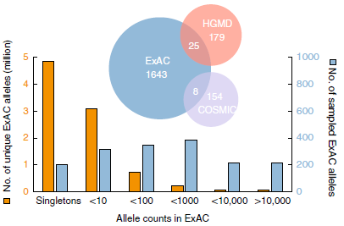
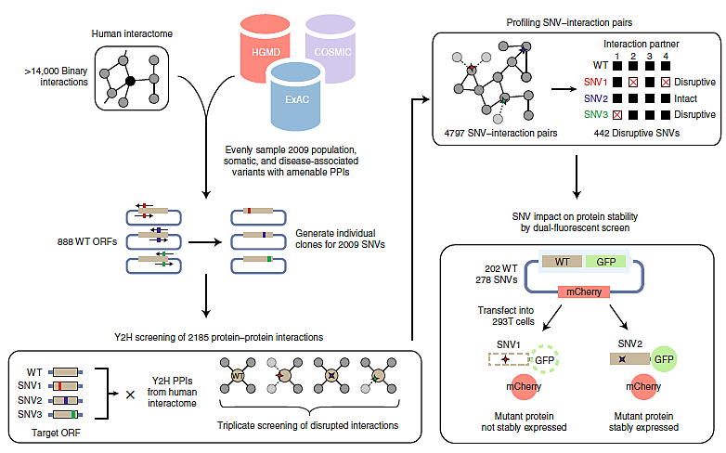
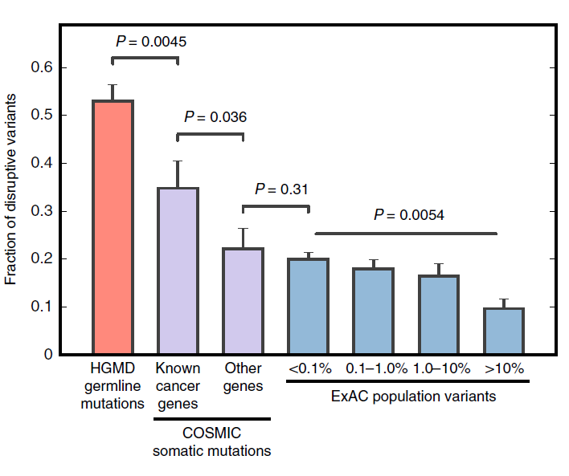
Molecular Interactions
Disease mutations often modify
molecular interactions
Mutation/Disease Correlation
Fragoza et al. Nat Com 10:4141(2019); PMID:31515488

Slide 10
Molecular Interactions
Why do we care ?
Protein interactions reflect protein function
To know how protein works means to know when and with what other molecules it interacts with
Disruption of protein interactions often correlate with disease
Knowing perturbation of the protein function in disease helps to understand its mechanism and might provide insights into potential therapies

Slide 11
Experimental Methods
Notes:
Title

Slide 12

Molecular Interactions
Why do they come from?
Function
What does a protein do in a cell ?
What happens when a protein is missing ?
What happens when a protein is altered ?
Gene Ontology Annotation
Computer-readable description of function
Three complementary sections
Biological process
Molecular function
Cellular localization
Each GO term is backed up by evidence

Slide 13
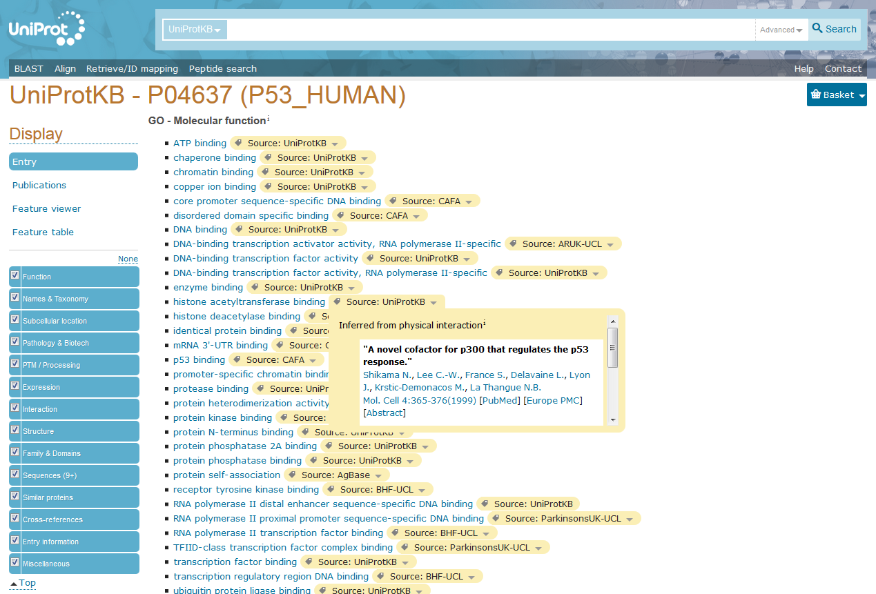
Molecular Interactions
Why do they come from?
Function
What does a protein do in a cell ?
What happens when a protein is missing ?
What happens when a protein is altered ?
Gene Ontology Annotation
Computer-readable description of function
Three complementary sections
Biological process
Molecular function
Cellular localization
Each GO term is backed up by evidence
Experimental evidence
Physical interaction
Enzymatic assay
Expression level
....
Sequence similarity
Curator’s inference
.....

Slide 14
Interaction Experiments: Caveats
Protein interactions are determined by 3D structure of a folded protein chain
Experimental conditions matter (ionic strength, pH, temperature, cofactors, etc)
Possible cellular compartment and tissue specificity
Protein interactions might be modulated by post-translational modifications
Phosphorylation, methylation, etc. might matter
Protein interactions might be transient
Life-cycle, cell-cycle, stimuli response, etc. might modify interaction patterns
Notes:
This is in contrast to NGS – DNA sequence is determined by stable, covalent bonds; only primary structure matters

Slide 15
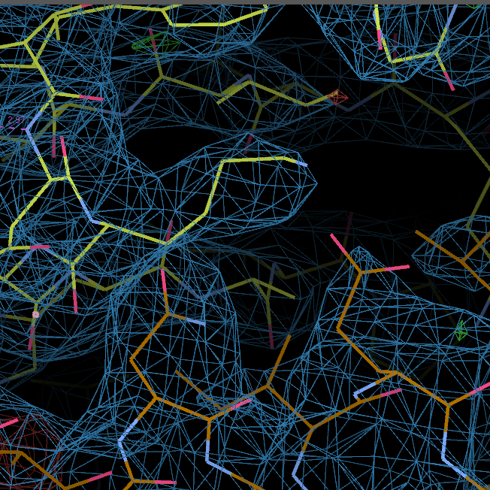
Interaction Experiments: Methods
X-Ray Crystallography
PDB: 3SN6
Advantages
Detailed, atom-level description of the interacting molecules
Disadvantages
Expensive/slow/might not work at all
Only one static image at a time
Electron density + Model
Fusion of a fragment of human β₂-AR with lysozyme fusion expressed in insect (Sf9) cells
Gαs (bovine), Gβ₁ (rat, His-tagged) and Gγ₂ (bovine) co-expressed in insect (HiFive) cells
Camel nanobody expressed in E. coli
In vitro complex reconstitution
Structure determined by X-ray crystallography to 3.2A
PDB: 3SN6
Rassmussen et al. Nature 477:549-555(2011); PMID: 21772288
Notes:
Complex formed by beta2-adrenergic receptor and a trimeric G-protein. T4 Lysozyme and antibody (nanobody) were used to stabilize reconstituted complex and to increase its water-exposed surface in order to improve crystal quality. Reconstitution of the complex involved multiple steps, each of which had to be optimized.

Slide 16
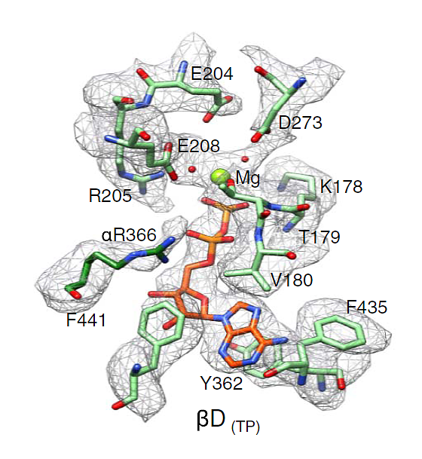
Interaction Experiments: Methods
Cryo-EM (cryogenic electron microscopy)
Native expression (spinach)
Cryo-EM structure determination
2.9-3.8A resolution
PDB: 6FKF
Hahn et al. Science 360:eaat4318 (2018); PMID: 29748256
Notes:
Cryo-EM structure at 2.9-3.8A resolution of natively expressed spinach ATP-synthase. Enough detail to trace individual protein chains and identify proteins by following patterns of size/shape of amino acid side chains. Rarely possible for natively expressed protiens. In this particular case the complexes are stable enough and highly concentrated in one compartment of an organelle which makes them easy (easier ?) to purify. Due to technical advances, resolution of cryo-EM structures improved within last 5 years to provide information comparable to that of crystal structures.

Slide 17
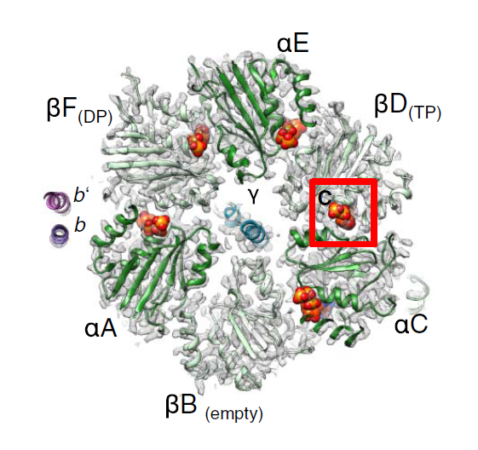
Interaction Experiments: Methods
Cryo-EM (cryogenic electron microscopy)
Conformational states provide insight into mechanism of ATP synthesis
PDB: 6FKF
PDB: 6FKH
PDB: 6FKI
Hahn et al. Science 360:eaat4318 (2018); PMID: 29748256
Notes:
Small fraction of complexes (~20%) existed in two other conformational states that could have been identified and their structure determined (4-8A resolution)

Slide 18
Interaction Experiments: Strategies
Structure determination
Advantages
Detailed, atom-level description of the interacting molecules
Disadvantages
Expensive/slow/might not work at all
Only one static image at a time
X-Ray/Electron/Neutron diffraction
Cryo-EM
NMR spectroscopy
Copurification
Notes:
Small fraction of complexes (~20%) existed in two other conformational states that could have been identified and their structure determined (4-8A resolution)

Slide 19
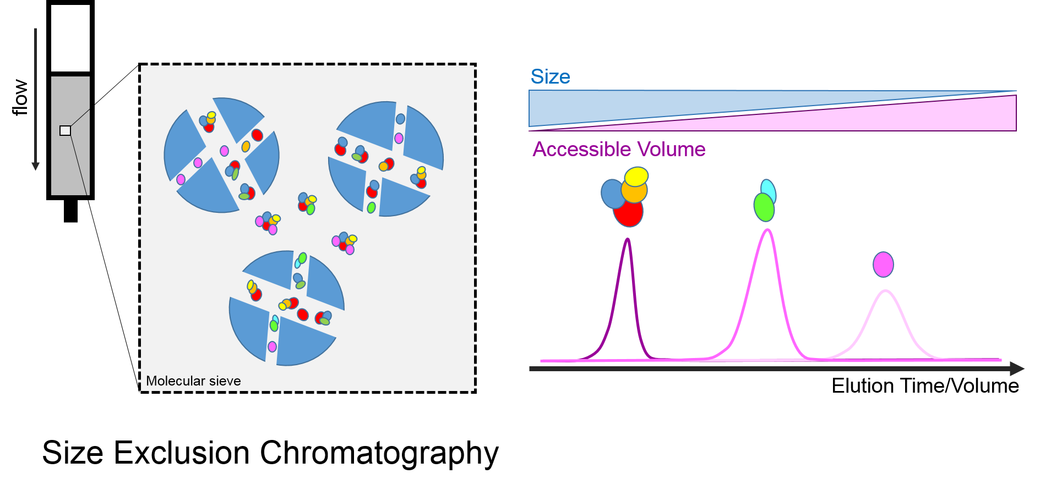
Interaction Experiments: Methods
Chromatography/Co-purification
Size Exclusion Chromatography
Notes:
If needed, proteins might have been identified by Western blot, LS-MS/MS of individual bands, N-terminal sequencing (Edman degradation) of individual bands.
The overlapping shapes of the elution profiles of individual components might suggest that there is just one physical complex; stoichiometry might be hard to evaluate, small components might be overlooked, contaminating proteins might be present.
Need to mention MS of native complexes somewhere!!!!

Slide 20
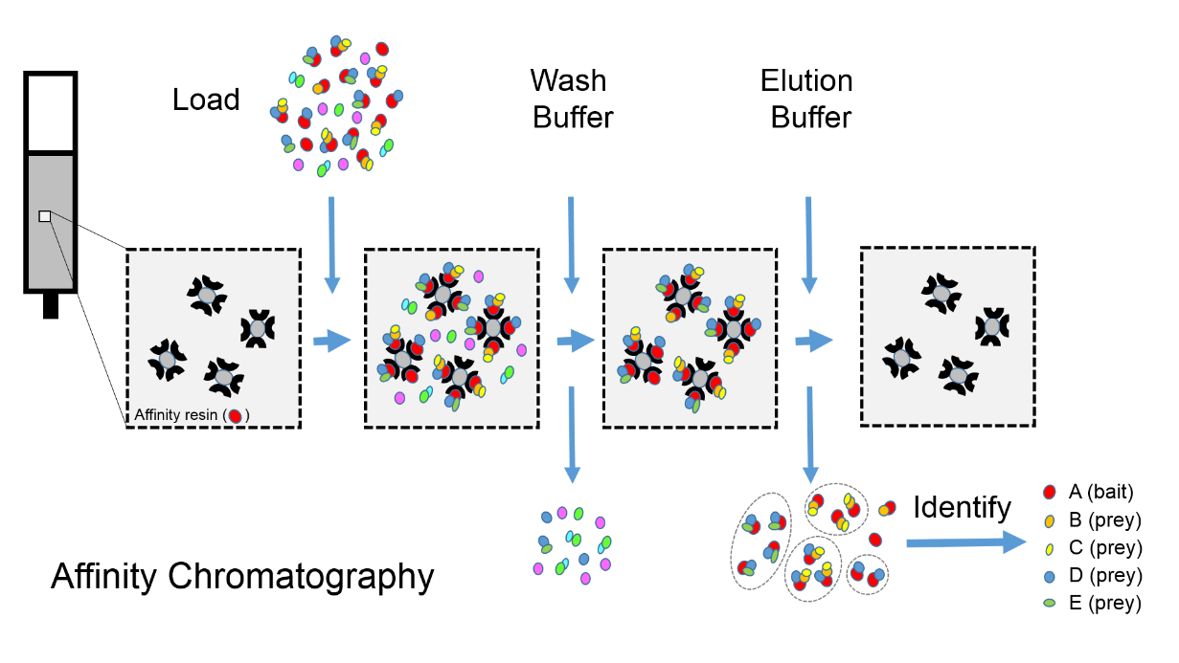
Interaction Experiments: Methods
Chromatography/Co-purification
Affinity Chromatography
Notes:
As before, proteins may be identified by Western blot, LS-MS/MS of individual bands, N-terminal sequencing (Edman degradation) of individual bands. Presence of predetermined components may be confirmed by non-specific staining (eg Coomassie). Affinity based methods DO NOT GUARANTEE that all the proteins are components of the same complex.

Slide 21
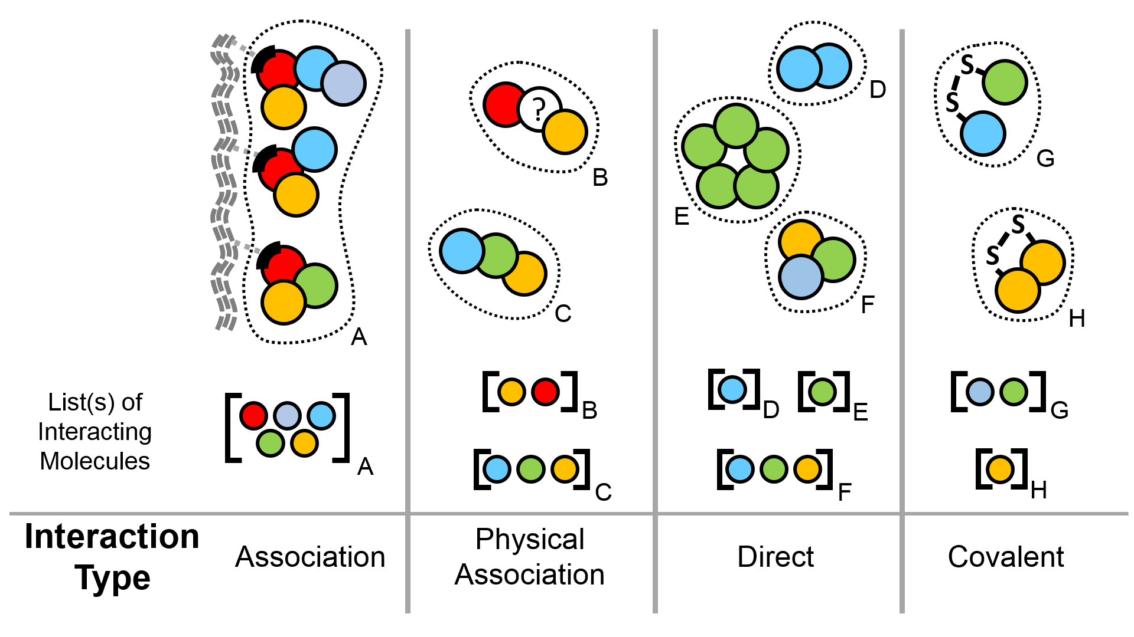
Interaction Types
B
Notes:
Ideally, experiment would provide complete information about spatial relationship between individual protein molecules. This is no always the case – only a small fraction of experiments let us infer which protein molecules within a protein complex are in direct contact or connect through covalent bonds. In most of the cases only partial inferences can be drawn. The types are assigned in such way that it is possible to consistently assign interaction type to binary interactions derived from interactions between multiple proteins.

Slide 22
Interaction Experiments: Methods
Chromatography/Copurification
Overexpression (human) of doubly-tagged (FLAG & HA) human H2A, H2A.Z & ANP32E proteins
Tandem affinity purification of interacting partners
Mass spectrometric and/or Western blot protein identification
MS
BAITS
Western
Affinity Chromatography
Obri et al. Nature 505:648-53 (2014); PMID: 24463511
Notes:
As before, proteins may be identified by Western blot, LS-MS/MS of individual bands, N-terminal sequencing (Edman degradation) of individual bands. Presence of predetermined components may be confirmed by non-specific staining (eg Coomassie). Affinity based methods DO NOT GUARANTEE that all the proteins are components of the same complex.

Slide 23
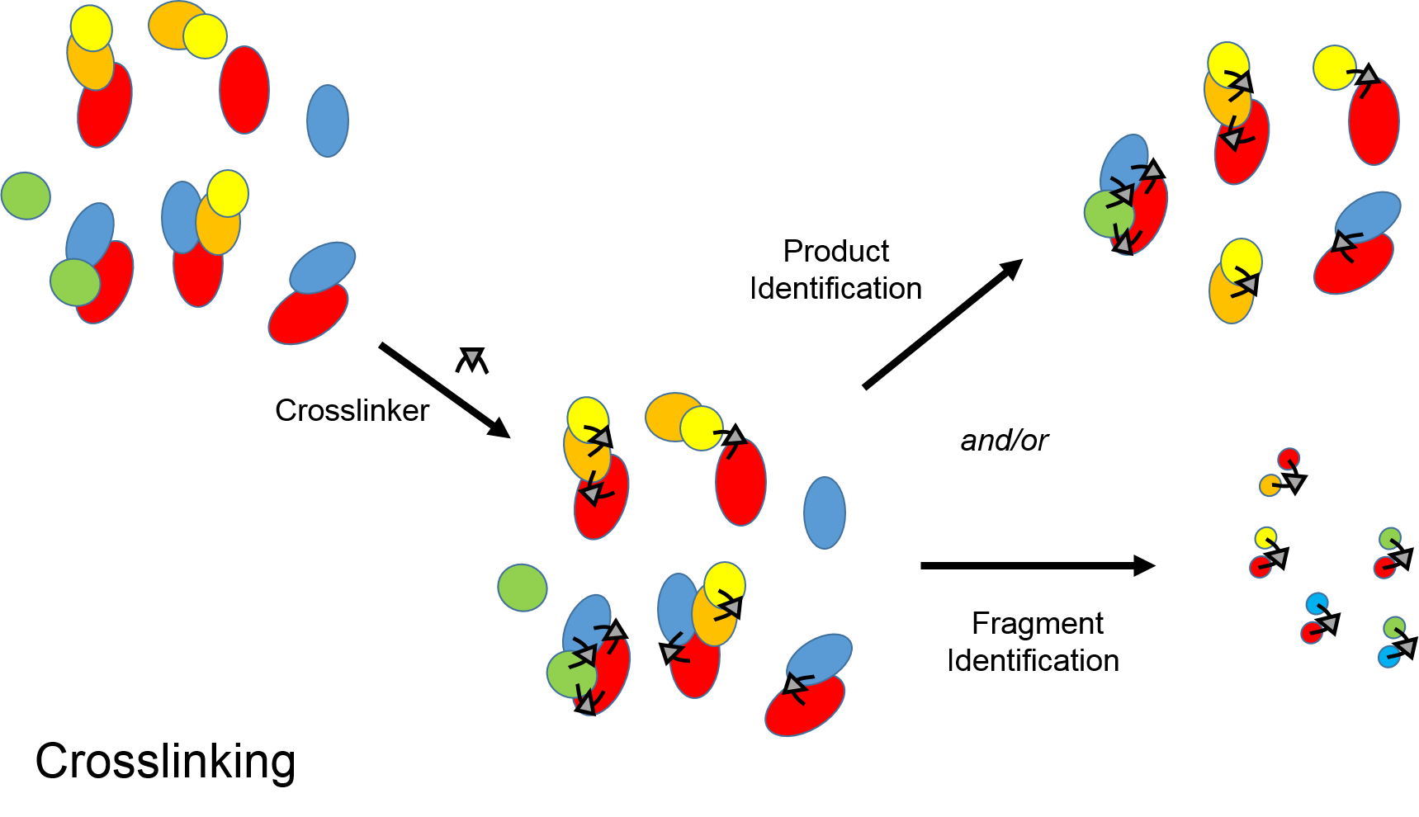
Interaction Experiments: Methods
When interacting complexes are not stable enough...
Advantages
Cheap/Fast
Can be used to identify interacting regions/residues
Can detect weak interactions...
Disadvantages
... and also innocent bystanders
Chemical/Photochemical
Crosslinking
Notes:
Not all interaction complexes are stable. Some interaction might be weak/transient/cofactor-dependent/etc. These can be stabilized by chemically ‘stapling’ interacting molecules. This strategy, effectively, creates covalent bonds linking nearby molecules. Resulting complexes can be isolated and identified using a varielty of methods - SDS-PAGE followed by Coomassie and/or Western blots and LC-MS/MS are common.

Slide 24
Interaction Experiments: Strategies
Advantages
Detailed, atom-level description of the interacting molecules
Disadvantages
Expensive/slow/might not work at all
Only one static image at a time
Structure determination
X-Ray/Electron/Neutron diffraction
Cryo-EM
NMR
Copurification
Chromatography (size exclusion, affinity, ion exchange, reversed phase....)
Native electrophoresis
Co-sedimentation
Advantages
Cheap/Fast
Amenable to high-throughput approaches
Disadvantages
Often only partial information:
Missing components
No stoichiometry
No contacts
Might miss weak/transient interactions
Advantages
May provide very detailed information about one particular interaction
May be customized to address one particular question about interaction
Disadvantages
Might be slow and/or not amenable to high throughput approaches
Might require specialized equipment
Solid Phase Assays
ELISA (enzyme linked immunosorption assay)
Membrane-binding/far western assays
SPR (surface plasmon resonance) and like
...
Biochemical/biophysical property perturbation
Spectroscopy-based methods (UV/Vis, Fluorescence, NMR, Mass Spec, etc)
Thermochemistry (calorimetry – ITC, DSC; thermal stability)
Co-sedimentation
...
Notes:
Small fraction of complexes (~20%) existed in two other conformational states that could have been identified and their structure determined (4-8A resolution)

Slide 25
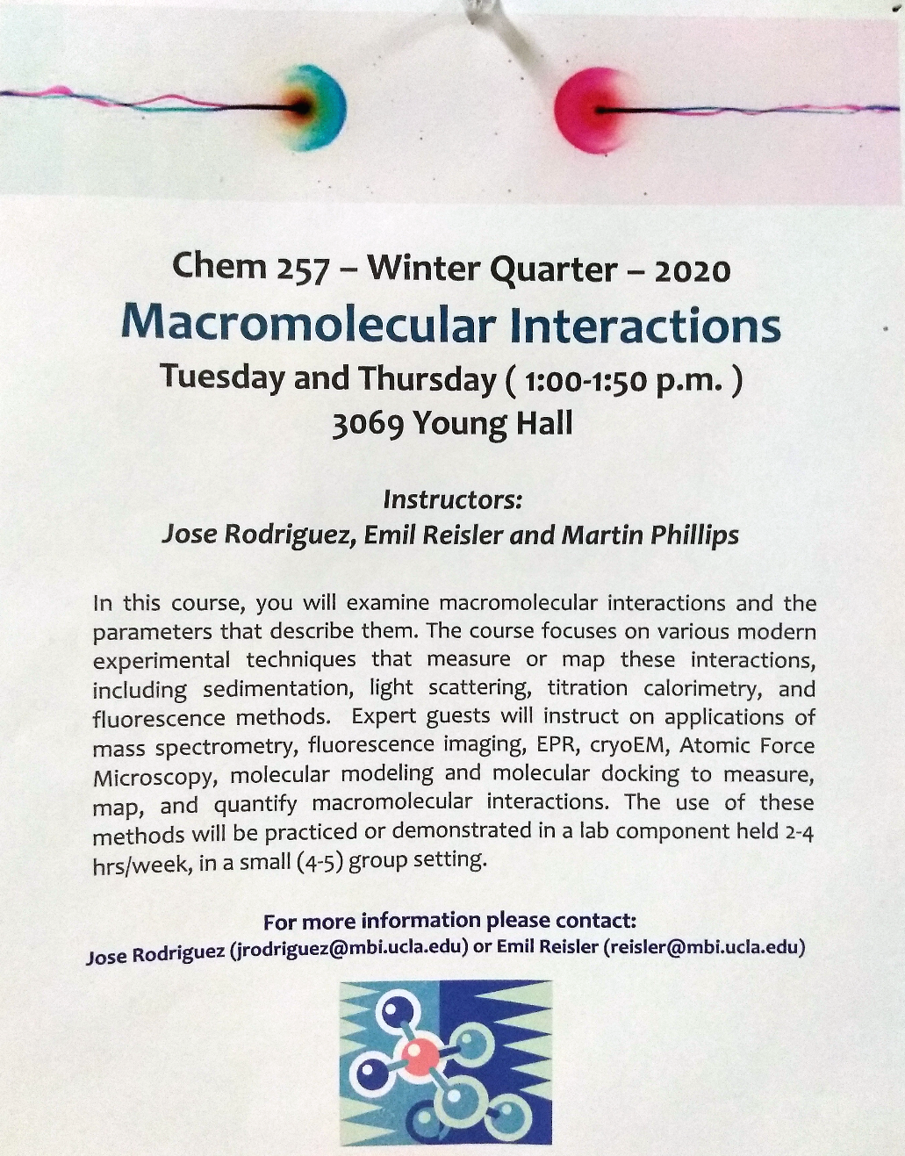
Interaction Experiments
Where to learn more ?
Structural methods
Crystallography and Structure Determination Core Facility
https://www.doe-mbi.ucla.edu/x-ray-crystallography-core-technology-center/
Crystallization Core Facility
https://www.doe-mbi.ucla.edu/crystallization/
Biosciences NMR Core Facility
https://www.doe-mbi.ucla.edu/ucla-doe-biosciences-nmr-core-facility/
M230B/M230D: Winter quarter (annually)
principles of X-ray crystallography, cryo-EM and NMR
Lecture (M230B) and hands-on lab (M230D)
Non-registered participants OK
230D Syllabus: https://people.mbi.ucla.edu/sawaya/m230d

Slide 26
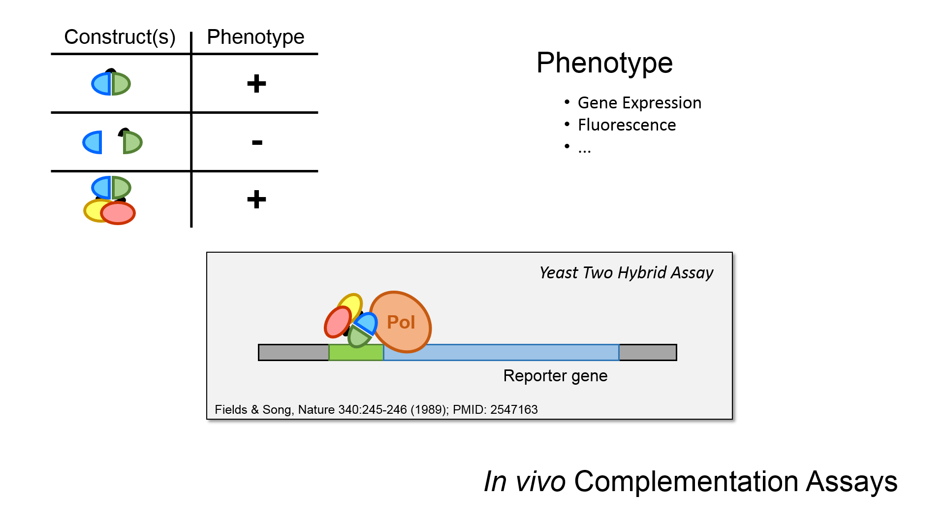
Interaction Experiments
Complementation Assays
Notes:
Biology-based functional assays; Y2H, split Ub, split gfp,

Slide 27

Interaction Experiments: Methods
Complementation Assays
B
Overexpression (yeast) of rat CNGA3 (fragment) & CDH23 (+/- exon 68) proteins fused, respectively to DNA and activation domains of Gal4 (transcription factor)
Yeast strain (Y187) with Ura3 marker under control of Gal4 promoter
Selection on minimal/-uracil medium
B CNGA3 CNGA3 - CDH23 CDH23 -
P CDH23 - CDH23 CNGA3 - CNGA3
In vivo Complementation Assays
Selvakumar et al. JBC 288:7215-7229 (2014); PMID: 23329832
Notes:
Biology-based functional assays; Y2H, split Ub, split gfp,

Slide 28
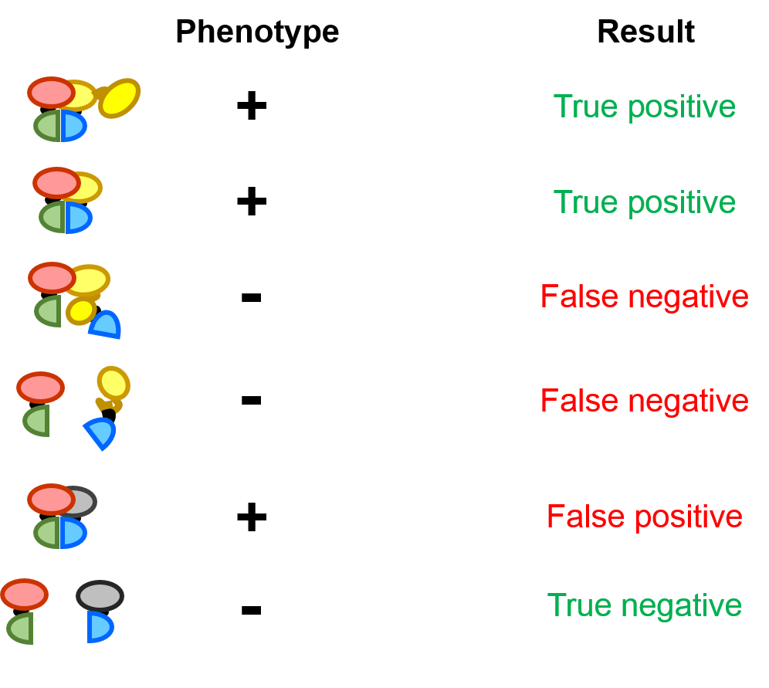
Interaction Experiments
Complementation Assays
AD
cDNA library
In vivo Complementation Screens
Notes:
These are the initial semi-high throughput experiments that allowed to search for, in principle all, interacting partners of one particular protein. They were possible without knowing the genome sequences by preparing cDNA-derived libraries of preys.
Some methods (in particular, in vivo complementation and affinity purification + LC-MS/MS) are amenable to high throughput approach. In most of the cases only one type of experiment is performed and thus the results are sensitive to artifacts/biases of one particular method that do have a chance to manifest themselves multiple time due to large nuber of tested interactions. Such issues are largely avoided in conventional publications, which describe a small number of experiments, as in a typical publication the same interaction is tested in multiple experimental systems. A typical experimental flow will start with Y2H followed by GST pull-down of recombinant proteins followed by coIP of native proteins.

Slide 29
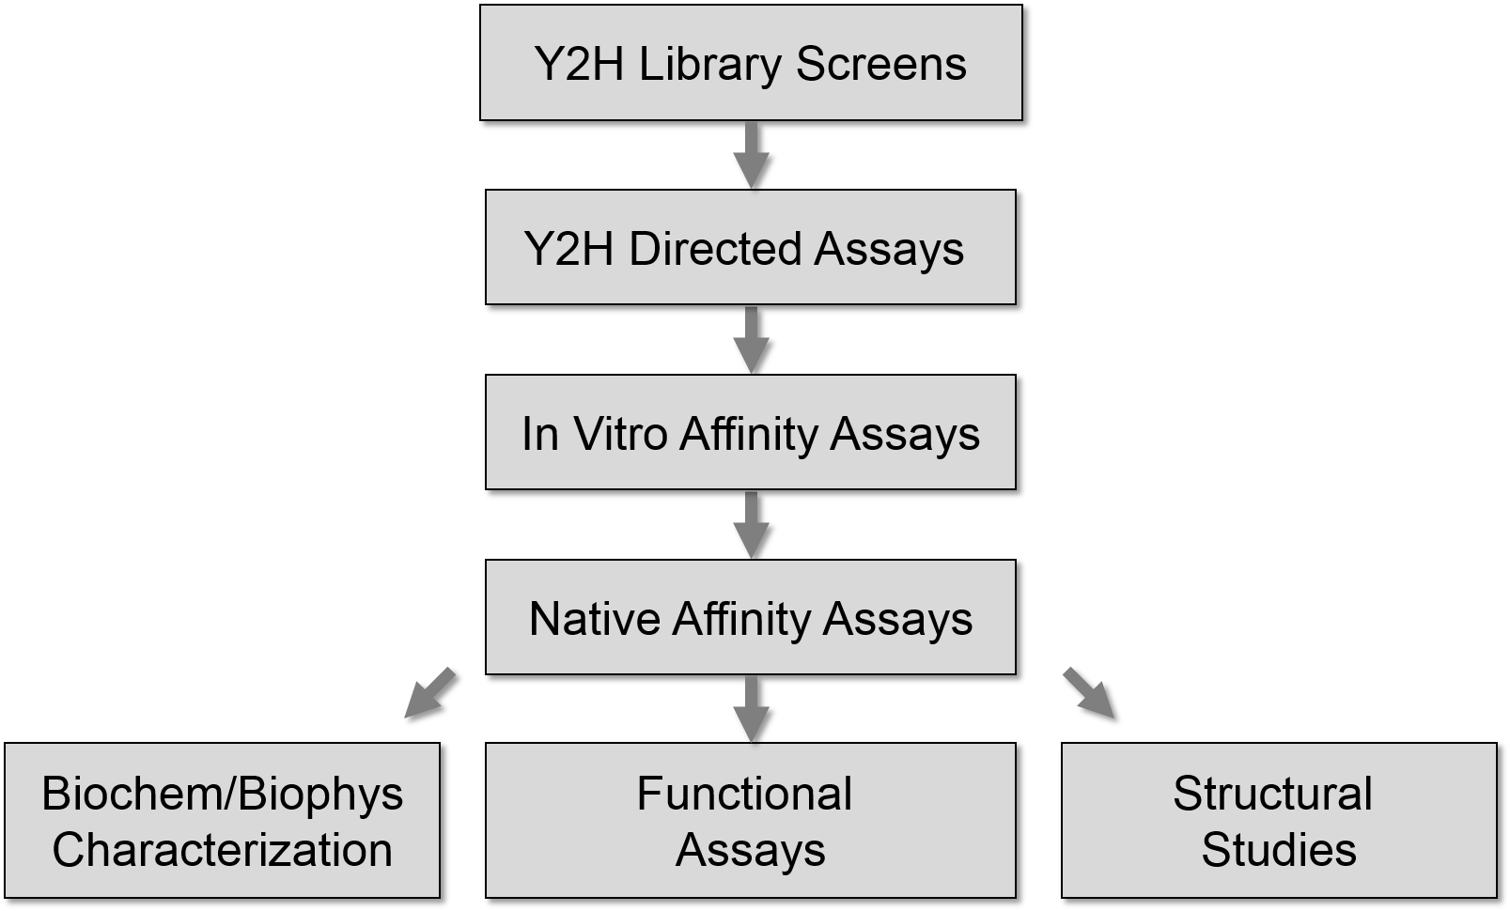
Interaction Experiments: Typical Workflows
B
Common alternative
Affinity Capture
+
LC/MS-MS
Notes:
Typical workflow of experimental work roughly reverses the order the methods were reviewed, starting with Y2H (or, more recently, affinity/MS) screen, followed by directed y2h assays, in vitro affinity, native system affinity and functional assays, colocalization, etc. if the authors are convinced the interaction is relevant further biochemical/biophysical characterization and, possibly, structural experiments follow.

Slide 30
Interaction Experiments: Typical Workflows
B
High-Throughput
One method only
Limited/no follow up
Computational evaluation/validation
Notes:
Typical workflow of experimental work roughly reverses the order the methods were reviewed, starting with Y2H (or, more recently, affinity/MS) screen, followed by directed y2h assays, in vitro affinity, native system affinity and functional assays, colocalization, etc. if the authors are convinced the interaction is relevant further biochemical/biophysical characterization and, possibly, structural experiments follow.

Slide 31
Interaction Experiments
Different experimental approaches may provide different (and often complementary) information about molecular interactions
Many experimental approaches provide only partial information about molecular interactions that may result in experimental ambiguities of protein identities and interaction type

Slide 32
Interaction Database
Records
Notes:
The primary (ie these created during the curation process) interaction records in fact describe *experiments* that demonstrated individual interacton takes place. The details of individual records might be different (XML vs JSON vs table; UniProt vs RefSeq vs species-specific dbid; different CV used) but, because they describe experiments, the overall structure of the records is similar and reflects the flow of the interaction experiment. This is similar to what wwPDB reports (each PDB record is a report on *experiment*) and is *different* from eg UniprotKB record where only final inferences derived from many experiments are presented. Databases that ‘integrate’ interactions from various sources tend to discard most of the experimental details and often come up with a stripped down, interaction-centric records that merge information obtained from individual experiments. There is more than one way to merge interaction data – some might be suitable for one particular application but not for others. The differences arise, mostly, due to different identity criteria applied to proteins (identical sequence and PTMs, identical sequence disregarding PTMs, identical gene irrespective of splice form, different but otherwise identical/duplicated genes; orthologs might be deemed identical).

Slide 33
Interaction Experiment Flow
Make proteins
Get them together
Test which ones interact
Identify proteins that interact
Where: native vs heterologous host vs in vitro translation vs chemical synthesis
How much: native level vs overexpressed
Modifications: isoforms, fragments, mutations, PTMs present/absent
Where: native organism/cell type/tissue/compartment vs something else
When: cell cycle phase/cell state
Diverse methods can be used to determine that that proteins interact
Information that can be inferred from each experiment depends on the method and experimental setup
?
Identity of some proteins might be known a priori (eg purified, cloned/ tagged bait, etc)
Identity and/or state of some proteins might be ambiguous (eg unknown splice form, PTMs)
Some molecules participating in the interaction might remain unidentified
C
B
D
F
Notes:
Experiments demonstrating interactions between proteins (or any other type of molecules) are very diverse. However, no matter how different are, they follow the same generic steps. Interaction records provide information about each step although not always grouped according to the experiment flow. A large number of fields within interaction record might describe details of the experimental procedure. These might be not related to and do not describe biology but might be helpful for quality control.

Slide 34
Interaction Experiment Record
Interaction Record
Interaction Experiment
Interaction Detection Method: Pull down (MI:0096)
Experiment Host/Cell Line: in vitro
Interaction Type: Direct (MI:0407)
Make Proteins
Participant List
1
2
Molecule Type: Protein (MI:0326)
Molecule Name: Cellular tumor antigen p53
Molecule Symbol: p53
Species of Origin: Human (Taxid:9606)
Cross-reference(s): P04637-1 (UniProtKB), NP_00537, (RefSeq), …
…
Get the Proteins Together
N
Experimental Role: Bait (MI:0496)
Experimental Source: E.coli K12 (Taxid: 83333)
Identification method(s): Predetermined (MI:0396)
Features:
Test Which Proteins Interact
1
2
Feature Type: Sufficient binding region (MI:0442)
Feature Range: 1-73
Identification Method: Deletion analysis (MI:0033)
…
M
Identify/Re-identify Proteins
That Interacted
Notes:
The list of proteins listed for a particular experiment is ultimately determined after testing which proteins were interacting. Apart from information about identity, each protein will be annotated with information about the organism/cell line the protein was produced in (in vitro translation & chemical synthesis is also possible). Additional information might include expression level (native/overexpressed) & purification state.

Slide 35
Interaction Experiment Record
Interaction Record
Interaction Experiment
Interaction Detection Method: Pull down (MI:0096)
Experiment Host/Cell Line: in vitro
Interaction Type: Direct (MI:0407)
Make Proteins
Participant List
1
2
Molecule Type: Protein (MI:0326)
Molecule Name: Cellular tumor antigen p53
Molecule Symbol: p53
Species of Origin: Human (Taxid:9606)
Cross-reference(s): P04637-1 (UniProtKB), NP_00537, (RefSeq), …
…
Get the Proteins Together
N
Experimental Role: Bait (MI:0496)
Experimental Source: E.coli K12 (Taxid: 83333)
Identification method(s): Predetermined (MI:0396)
Features:
Test Which Proteins Interact
1
2
Feature Type: Sufficient binding region (MI:0442)
Feature Range: 1-73
Identification Method: Deletion analysis (MI:0033)
…
M
Identify/Re-identify Proteins
That Interacted
Notes:
Interaction host is the place where the proteins used in this particular experiment (not ‘in general’) had the first chance to get in contact. It is often not the place where it was ultimately demonstrated they interact!!!!

Slide 36
Interaction Experiment Record
Interaction Record
Interaction Experiment
Interaction Detection Method: Pull down (MI:0096)
Experiment Host/Cell Line: in vitro
Interaction Type: Direct (MI:0407)
Protein
Expression
Interaction
Host
Participant List
1
2
S. cerevisiae
Molecule Type: Protein (MI:0326)
Molecule Name: Cellular tumor antigen p53
Molecule Symbol: p53
Species of Origin: Human (Taxid:9606)
Cross-reference(s): P04637-1 (UniProtKB), NP_00537, (RefSeq), …
…
N
E. coli
Experimental Role: Bait (MI:0496)
Experimental Source: E.coli K12 (Taxid: 83333)
Identification method(s): Predetermined (MI:0396)
Features:
in vitro
1
2
Feature Type: Sufficient binding region (MI:0442)
Feature Range: 1-73
Identification Method: Deletion analysis (MI:0033)
…
M
in vitro
Notes:
Interaction host is the place where the proteins used in this particular experiment (not ‘in general’) had the first chance to get in contact. It is often not the place where it was ultimately demonstrated they interact – most of the ‘places’ that interaction is observed in correspond to some sort of equipment ( chromatographic column, electrophoresis gel, ultracentrifuge, etc). It is not that these are not interesting but they can be inferred from the interaction detection method.

Slide 37
Interaction Experiment Record
Interaction Record
Interaction Experiment
Interaction Detection Method: Pull down (MI:0096)
Experiment Host/Cell Line: in vitro
Interaction Type: Direct (MI:0407)
Make Proteins
Participant List
1
2
Molecule Type: Protein (MI:0326)
Molecule Name: Cellular tumor antigen p53
Molecule Symbol: p53
Species of Origin: Human (Taxid:9606)
Cross-reference(s): P04637-1 (UniProtKB), NP_00537, (RefSeq), …
…
Get the Proteins Together
N
Experimental Role: Bait (MI:0496)
Experimental Source: E.coli K12 (Taxid: 83333)
Identification method(s): Predetermined (MI:0396)
Features:
Test Which Proteins Interact
1
2
Feature Type: Sufficient binding region (MI:0442)
Feature Range: 1-73
Identification Method: Deletion analysis (MI:0033)
…
M
Identify/Re-identify Proteins
That Interacted

Slide 38
Interaction Experiment Record
Interaction Record
Interaction Experiment
Interaction Detection Method: Pull down (MI:0096)
Experiment Host/Cell Line: in vitro
Interaction Type: Direct (MI:0407)
Make Proteins
Participant List
1
2
Molecule Type: Protein (MI:0326)
Molecule Name: Cellular tumor antigen p53
Molecule Symbol: p53
Species of Origin: Human (Taxid:9606)
Cross-reference(s): P04637-1 (UniProtKB), NP_00537, (RefSeq), …
…
Get the Proteins Together
N
Experimental Role: Bait (MI:0496)
Experimental Source: E.coli K12 (Taxid: 83333)
Identification method(s): Predetermined (MI:0396)
Features:
Test Which Proteins Interact
1
2
Feature Type: Sufficient binding region (MI:0442)
Feature Range: 1-73
Identification Method: Deletion analysis (MI:0033)
…
M
Identify/Re-identify Proteins
That Interacted

Slide 39
Interaction Types
B
Notes:
Ideally, experiment would provide complete information about spatial relationship between individual protein molecules. This is no always the case – only a small fraction of experiments let us infer which protein molecules within a protein complex are in direct contact or connect through covalent bonds. In most of the cases only partial inferences can be drawn. The types are assigned in such way that it is possible to consistently assign interaction type to binary interactions derived from interactions between multiple proteins.

Slide 40
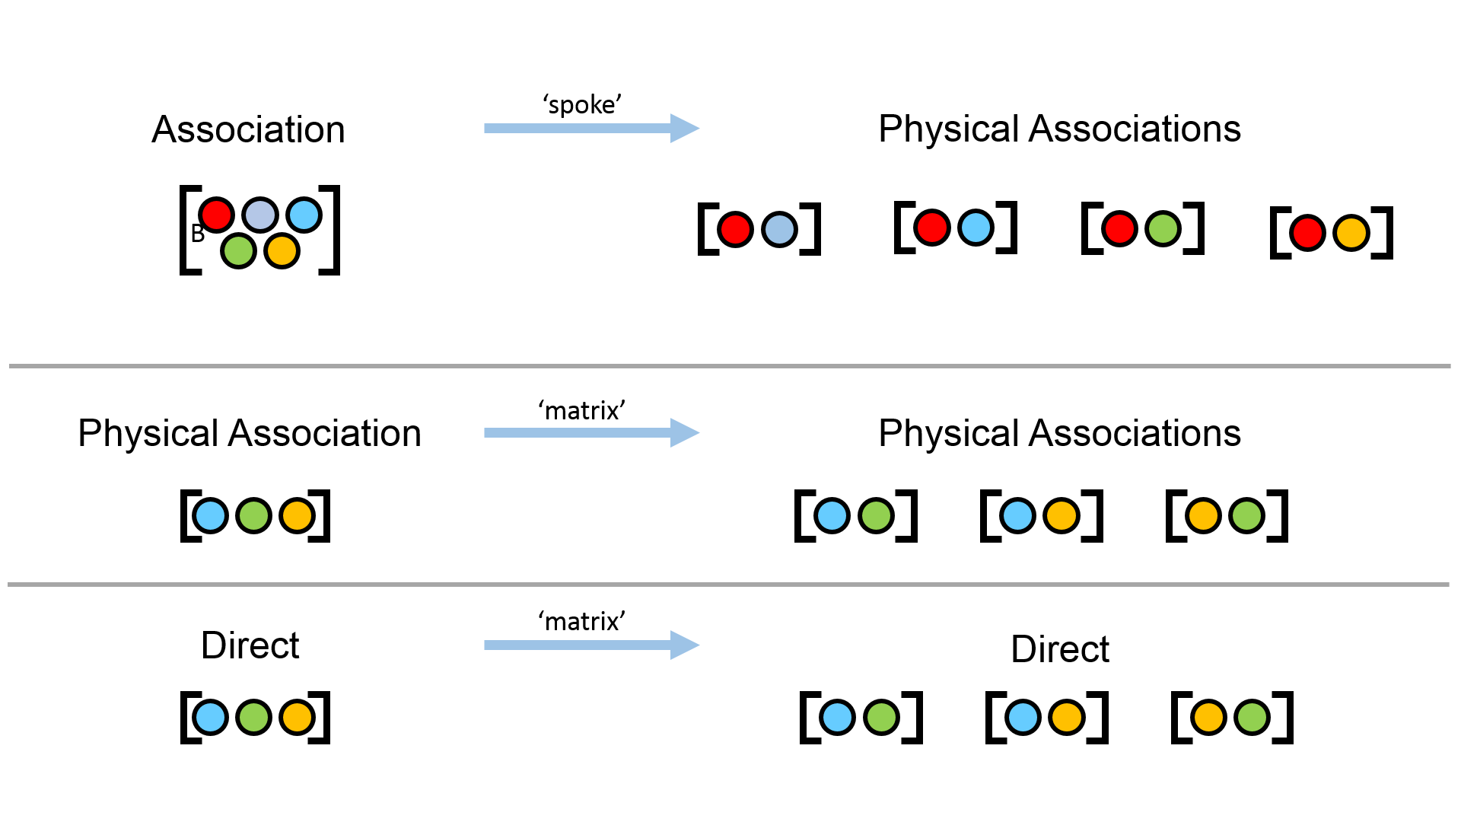
Binary Expansion
Notes:
Binary expansion rules. Binary expansion, early on, caused a lot of confusion, mostly due to misunderstanding of the results of affinity purification based experiment. It resulted in matrix expansion deemed ‘wrong’ but note that this is true only in case of associations. In case of physical associations and direct interactions matrix expansion is formally correct !!!

Slide 41
Interaction Experiment Record
Interaction Record
Interaction Experiment
Interaction Detection Method: Pull down (MI:0096)
Experiment Host/Cell Line: in vitro
Interaction Type: Direct (MI:0407)
Make Proteins
Participant List
1
2
Molecule Type: Protein (MI:0326)
Molecule Name: Cellular tumor antigen p53
Molecule Symbol: p53
Species of Origin: Human (Taxid:9606)
Cross-reference(s): P04637-1 (UniProtKB), NP_00537, (RefSeq), …
…
Get the Proteins Together
N
Experimental Role: Bait (MI:0496)
Experimental Source: E.coli K12 (Taxid: 83333)
Identification method(s): Predetermined (MI:0396)
Features:
Test Which Proteins Interact
1
2
Feature Type: Sufficient binding region (MI:0442)
Feature Range: 1-73
Identification Method: Deletion analysis (MI:0033)
…
M
Identify/Re-identify Proteins
That Interacted

Slide 42
Interaction Experiment Record
Interaction Record
Interaction Experiment
Interaction Detection Method: Pull down (MI:0096)
Experiment Host/Cell Line: in vitro
Interaction Type: Direct (MI:0407)
Make Proteins
Participant List
1
2
Molecule Type: Protein (MI:0326)
Molecule Name: Cellular tumor antigen p53
Molecule Symbol: p53
Species of Origin: Human (Taxid:9606)
Cross-reference(s): P04637-1 (UniProtKB), NP_00537, (RefSeq), …
…
Get the Proteins Together
N
Experimental Role: Bait (MI:0496)
Experimental Source: E.coli K12 (Taxid: 83333)
Identification method(s): Predetermined (MI:0396)
Features:
Test Which Proteins Interact
1
2
Feature Type: Sufficient binding region (MI:0442)
Feature Range: 1-73
Identification Method: Deletion analysis (MI:0033)
…
M
Identify/re-identify Proteins
That Interacted
Notes:
Identification methods may different for each protein participating in the interaction; some proteins might be identified using more than one method; identity of some proteins used in the experiment might be known beforehand (‘predetermined’) and never tested during the experiment;

Slide 43
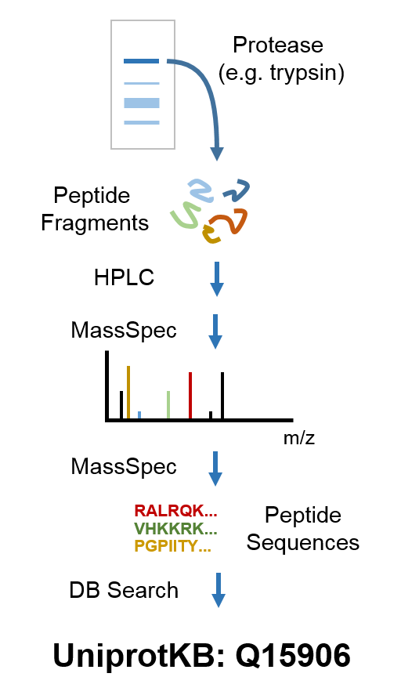
Protein Identification
MassSpec Protein
Identification Workflow
MS
Ambiguous !!!
Obri et al. Nature 505:648-53 (2014); PMID: 24463511

Slide 44
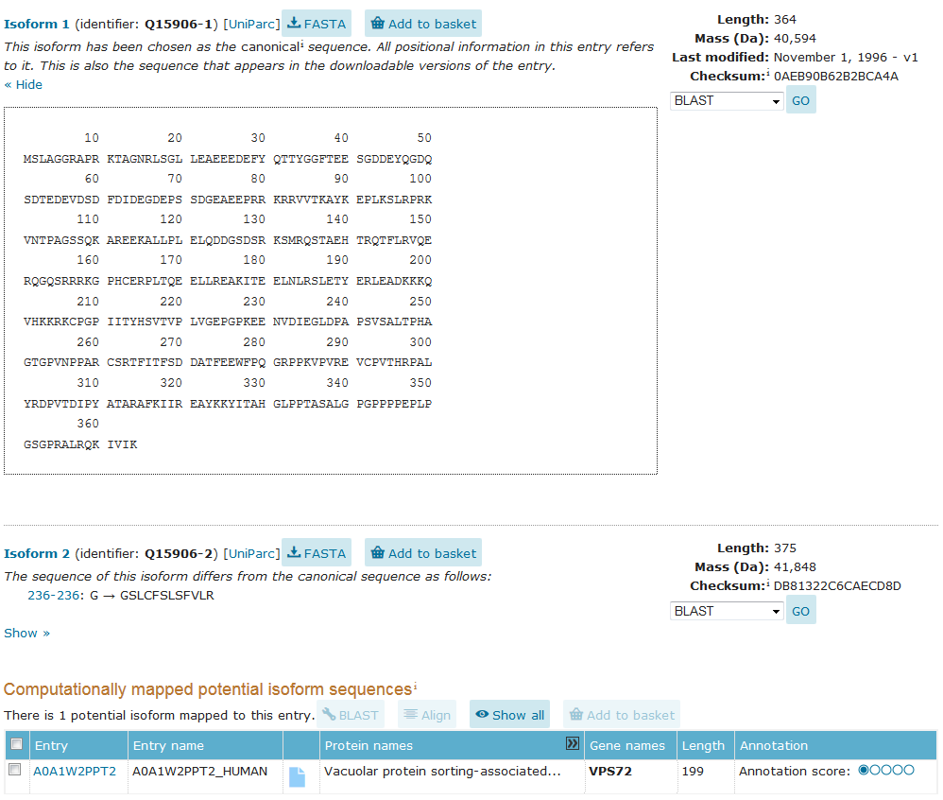
UniprotKB: Q15906
Experimental Ambiguities
In many cases multiple isoforms exist
It is hard to unambiguously demonstrate which one is present/absent
The problem is not unique to MS – similar issues arise when identifying endogenous proteins by Western blots
Notes:
Title

Slide 45
UniprotKB: Q15906
Annotation Ambiguities
In some cases there is no single identifier that covers all isoforms
In some cases there are multiple identifiers that cover the same protein
Database records change over time
Notes:
Title

Slide 46
Protein Identification
UniprotKB: P0C0S8
Gene duplication !!!
Obri et al. Nature 505:648-53 (2014); PMID: 24463511

Slide 47
PICR: Protein Identifier Cross Reference
R.I.P.
As of May 2019
URL: http://www.ebi.ac.uk/Tools/picr/
Hosted by EBI (Hinxton, UK)
Cross-references between close to a 100 of databases (UniProt, Refseq, Ensembl, model organisms, PDB, ...)
Stable ‘over time’ and over ‘interface’
Access in a batch mode and as a service (SOAP and RESTful)
Results presented in either tabular or HTML/XML format
Notes:
Title

Slide 48
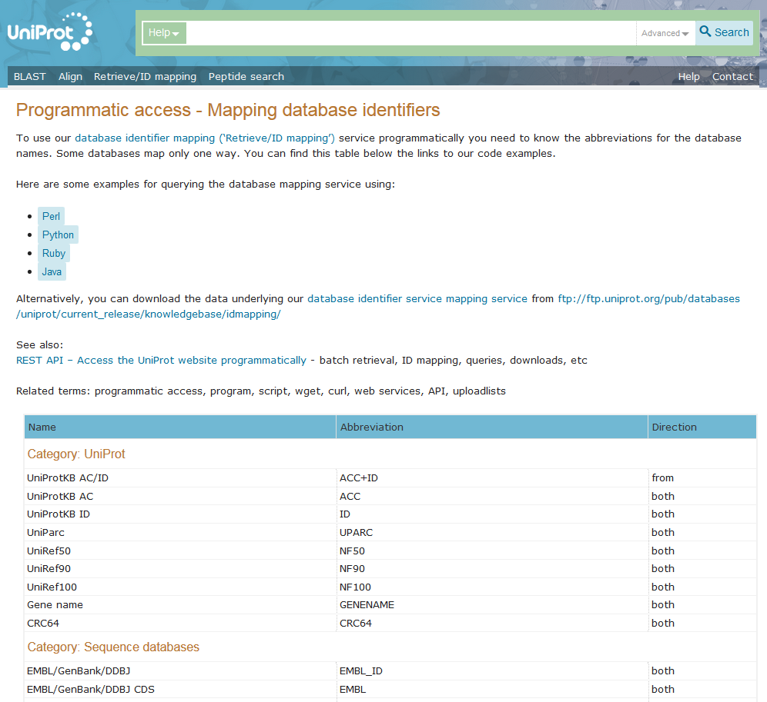
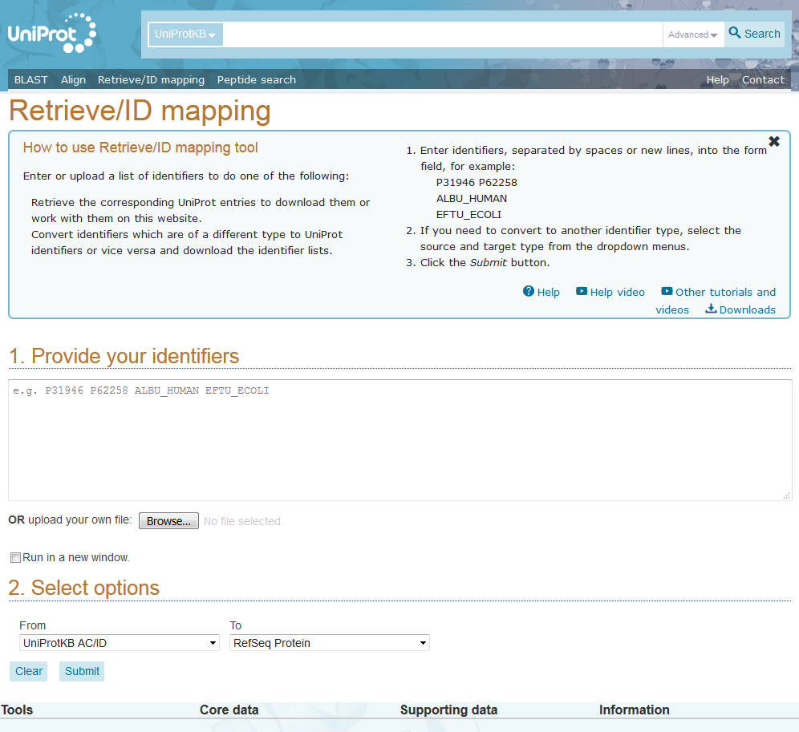
UniProtKB: Identifier Mapping
URL: https://www.uniprot.org/uploadlists/
Hosted by SIB (Geneva, Switzerland)
Cross-references between UniProtKB records and about 80 databases (Refseq, Ensembl, model organisms, PDB, ...)
Stable ‘over time’ and over ‘interface’
Access Results presented as 2 column table
in a batch mode and as a service (RESTful)
Notes:
Title

Slide 49
When are two proteins ‘identical’ ?
Possible criteria:
T4 phage
Identical sequence
Identical species (strain ?) of origin
Identical PTMs
Identical localization (space & time)
Identical gene
Same orthologous group
Human
Cow
Rat
Definition which proteins are treated as identical is project specific and likely different than the definition used by at least some authors of the interaction data.
Cow
Camel
PDB: 3SN6
Notes:
Interaction records report results of experiments that might have used proteins from different species. To my knowledge there is currently no well maintained protein interaction resource that systematically maps results of such experiments into one preferred species. The mapping has to be done by the users of the data. An alternative is to skip results of such experiments.

Slide 50
Protein Identification: Special cases
Somatic recombination
Not curated
V(D)J recombination
B-cell receptors/antibodies
T-cell receptors
class switching
antibodies
Gene Duplication
Curated if:
Identifier provided by the authors
Histone tails (as separate entities)
Histones
Multiple gene families, many genes/family
https://www.ncbi.nlm.nih.gov/research/HistoneDB2.0 (PMID:26989147)
Polyproteins
Viral proteins
Ubiquitin
Notes:
Ubiquitin.....

Slide 51
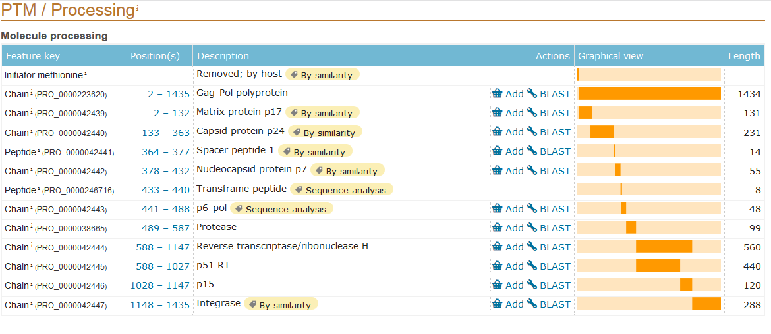
Protein Identification: Polyproteins
UniprotKB: P04585
P04585-PRO_0000042439
Notes:
Proteins that correspond to functionally autonomous fragments of a parent polyprotein are identified as P12345-PRO_0123456789 identified (UniprotKB). They might (or might not) have a corresponding entry in RefSeq or organism-specific database. Many of these come from different viral strains/isolates which might complicate analysis.

Slide 52
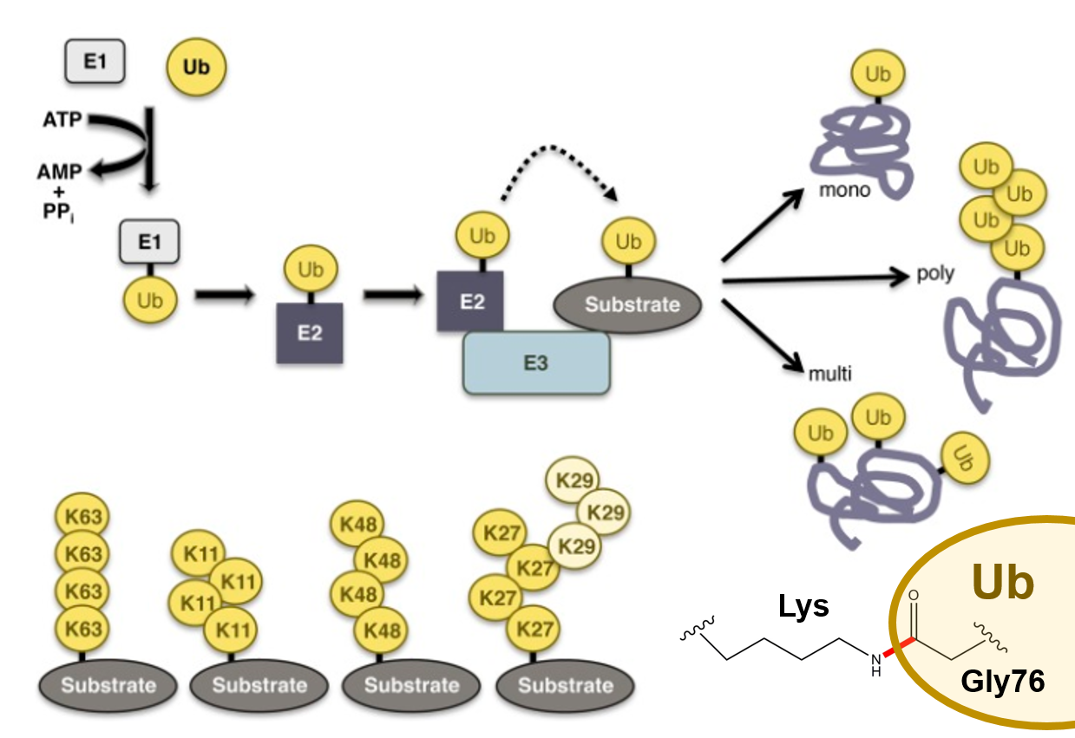
Protein Identification: Ubiquitin
Does NOT exist in UniProtKB, RefSeq, etc !!!
Ubiquitin is synthesized as a part of many polyproteins
Polyubiquitin
Human: UBB, UBC
Yeast: UBI4
Ribosomal protein fusions
Human: UBA52 (L40), RPS27A (S27a)
Yeast: UBI1 (L40), UBI2 (L40), UBI3 (S37)
Curated as depreciated UniprotKB protein
or
as PTM
modified
Finley et al. Genetics 192:319-360(2012); PMID: 23028185
Notes:
Ubiquitin requires caution: (a) might be refered to through obsoleted UniprotKB entry, (b) might be entered as a PTM (ubiquitineted Lysine), (c) might short-circuit unrelated pathways.

Slide 53
Interaction Experiment Record
Interaction Record
Interaction Experiment
Interaction Detection Method: Pull down (MI:0096)
Experiment Host/Cell Line: in vitro
Interaction Type: Direct (MI:0407)
Make Proteins
Participant List
1
2
Molecule Type: Protein (MI:0326)
Molecule Name: Cellular tumor antigen p53
Molecule Symbol: p53
Species of Origin: Human (Taxid:9606)
Cross-reference(s): P04637-1 (UniProtKB), NP_00537, (RefSeq), …
…
Get the Proteins Together
N
Experimental Role: Bait (MI:0496)
Experimental Source: E.coli K12 (Taxid: 83333)
Identification method(s): Predetermined (MI:0396)
Features:
Test Which Proteins Interact
1
2
Feature Type: Sufficient binding region (MI:0442)
Feature Range: 1-73
Identification Method: Deletion analysis (MI:0033)
…
M
Identify/re-identify Proteins
That Interacted
Notes:
Features that are present and/or shown to be relevant to the interaction demonstrated by the reported experiment. These might be deviations from the default sequence of the proteins, posttranslational modifications (aka PTMs) and experimental artifacts, such as tags. The features are specified by providing information about their type, localization within protein sequence, and the method used to demonstrate their relevance (if applicable).

Slide 54
Interaction Experiment Record
Interaction Record
Interaction Experiment
Protein Features
Interaction Detection Method: Pull down (MI:0096)
Experiment Host/Cell Line: in vitro
Interaction Type: Direct (MI:0407)
Deviations from the default sequence
Post-translational modifications (PTMs)
Experimental artifacts
Participant List
Mutations (substitutions, deletions, insertions)
Regions necessary/sufficient for binding
1
2
Molecule Type: Protein (MI:0326)
Molecule Name: Cellular tumor antigen p53
Molecule Symbol: p53
Species of Origin: Human (Taxid:9606)
Cross-reference(s): P04637-1 (UniProtKB), NP_00537, (RefSeq), …
…
N
Phosphorylation, methylation, etc
Ubiquitination sites
Experimental Role: Bait (MI:0496)
Experimental Source: E.coli K12 (Taxid: 83333)
Identification method(s): Predetermined (MI:0396)
Features:
1
Affinity tags (His, FLAG, TAP, GFP, ...)
Labels (biotin, isotope, fluorescent, spin labels,...)
Cross-linking sites
Proteolytic sites
2
Feature Type: Sufficient binding region (MI:0442)
Feature Range: 1-73
Identification Method: Deletion analysis (MI:0033)
…
M
Notes:
Features that are present and/or shown to be relevant to the interaction demonstrated by the reported experiment. These might be deviations from the default sequence of the proteins, posttranslational modifications (aka PTMs) and experimental artifacts, such as tags. The features are specified by providing information about their type, localization within protein sequence, and the method used to demonstrate their relevance (if applicable). The format used to specify feature localization might vary between different resources and record formats. Feature type typically comes from some sort of controlled vocabulary/ontology. Ubiquitin has a split personality – sometimes shows up as an interacting partner, sometimes it is added as a posttranslational modifications – and thus has to be handled with caution.

Slide 55
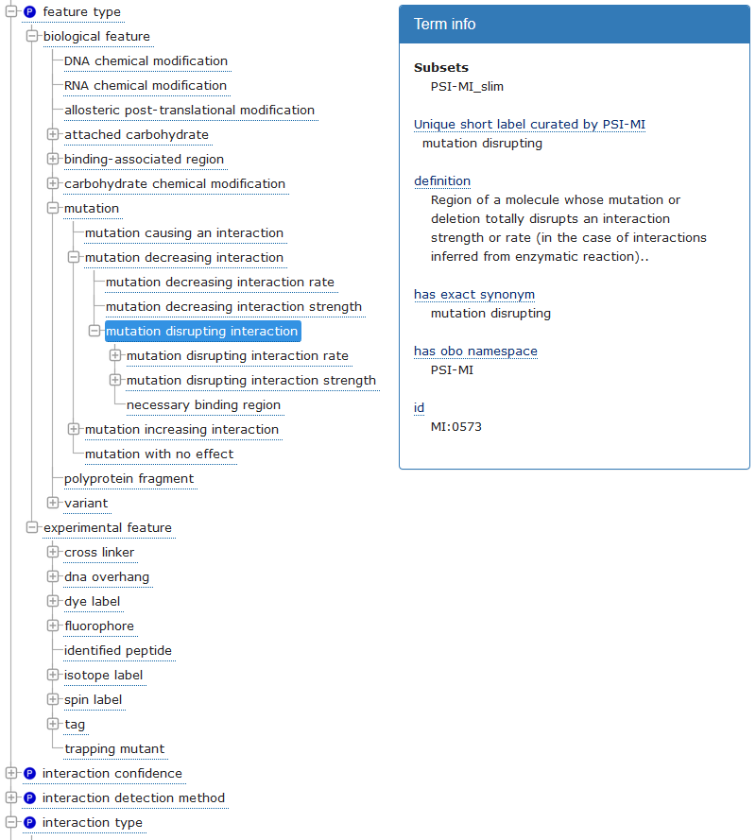
Controlled Vocabularies
Molecular Interactions (MI)
Controlled Vocabulary
Collection of terms, each with:
Unique identifier
Definition
Common aliases
Include most of the terms used to annotate molecular interactions
Provides relationships between terms
Most often of ‘is a’ type
Molecular Interactions
Controlled Vocabulary
Notes:
Controlled vocabularies – collection of terms (including aliases), each with definition and relationship to other terms (which makes them, formally, close to ‘ontologies’). Most often relationship is of ‘is a’ type which means once a term is assigned all the parent terms also apply.

Slide 56
Controlled Vocabularies
Molecular Interactions (MI)
Controlled Vocabulary
Feature type
is a
Biological feature
Collection of terms, each with:
Unique identifier
Definition
Common aliases
Include most of the terms used to annotate molecular interactions
Provides relationships between terms
Most often of ‘is a’ type
So, formally, MI is ‘ontology’
is a
Mutation
is a
Mutation decreasing interaction
is a
Mutation disrupting interaction
Molecular Interactions
Controlled Vocabulary
Notes:
Controlled vocabularies – collection of terms (including aliases), each with definition and relationship to other terms (which makes them, formally, close to ‘ontologies’). Most often relationship is of ‘is a’ type which means once a term is assigned all the parent terms also apply.

Slide 57
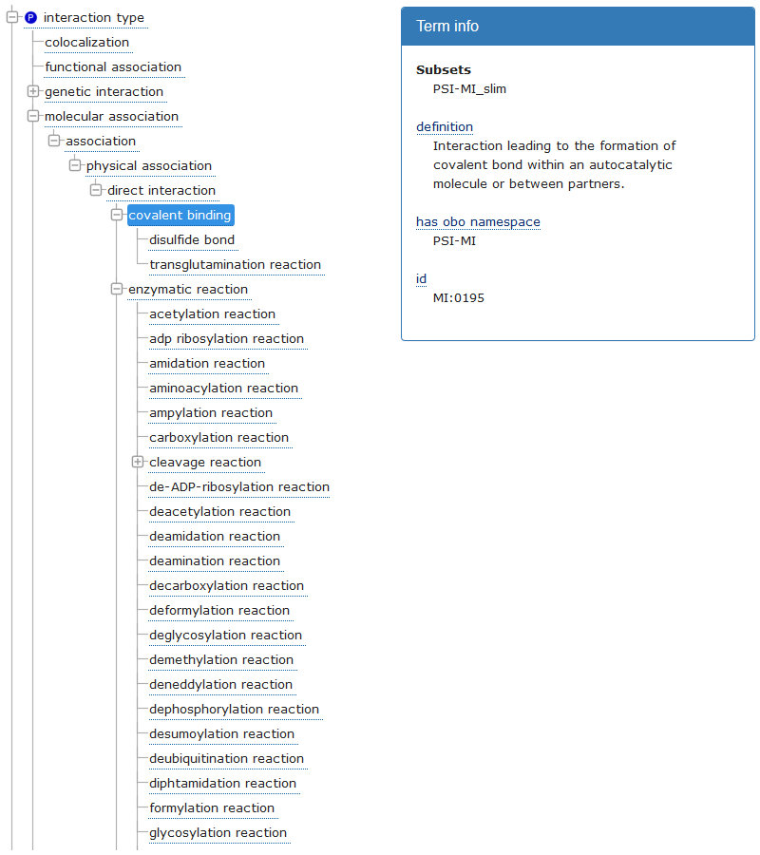
Controlled Vocabularies
Interaction Types
Association
is a
Physical Association
is a
Direct Interaction
is a
is a
Enzymatic Reaction
Covalent
Binding
Molecular Interactions
Controlled Vocabulary
Notes:
Relationships between interaction types are consistent with series of experiments characterizing interactions at increasing level of detail – a term corresponding to more detailed information (eg ‘direct binding’) includes also terms corresponding to less detailed information (‘physical association’ and ‘association’). The relationships between terms are important when comparing results of different experiments – some experiments remain consistent even though exact terms do mot match.

Slide 58
Interaction Types
B
Notes:
Ideally, experiment would provide complete information about spatial relationship between individual protein molecules. This is no always the case – only a small fraction of experiments let us infer which protein molecules within a protein complex are in direct contact or connect through covalent bonds. In most of the cases only partial inferences can be drawn. The types are assigned in such way that it is possible to consistently assign interaction type to binary interactions derived from interactions between multiple proteins.

Slide 59
Controlled Vocabularies
Interaction Types
Association
is a
Physical Association
is a
Direct Interaction
is a
is a
Enzymatic Reaction
Covalent
Binding
Molecular Interactions
Controlled Vocabulary
Notes:
Relationships between interaction types are consistent with series of experiments characterizing interactions at increasing level of detail – a term corresponding to more detailed information (eg ‘direct binding’) includes also terms corresponding to less detailed information (‘physical association’ and ‘association’). The relationships between terms are important when comparing results of different experiments – some experiments remain consistent even though exact terms do mot match.

Slide 60
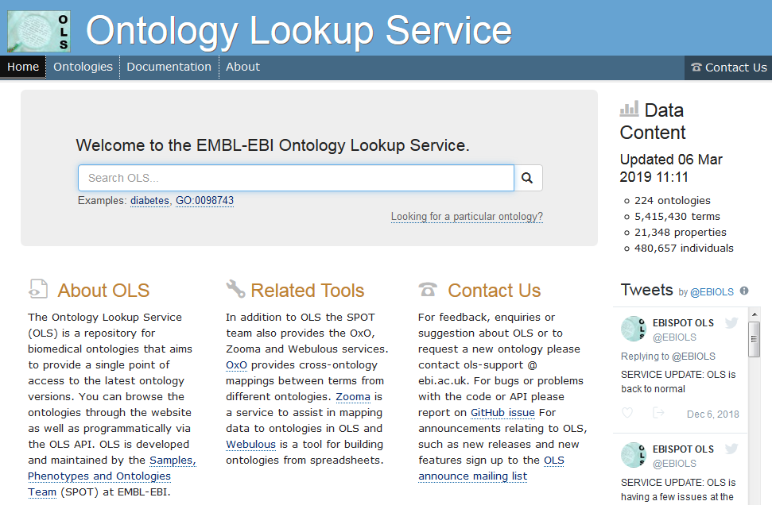
Controlled Vocabularies
Molecular Interactions (MI)
Controlled Vocabulary
URL: https://www.ebi.ac.uk/ols/ontologies/mi
Molecular Interactions
Controlled Vocabulary
Notes:
Controlled vocabularies are commonly used by biomedical databases. Information can by found on the OLS site. This is another (after UniProtKB, wwPDB and PICR) well established, stable reference service.

Slide 61
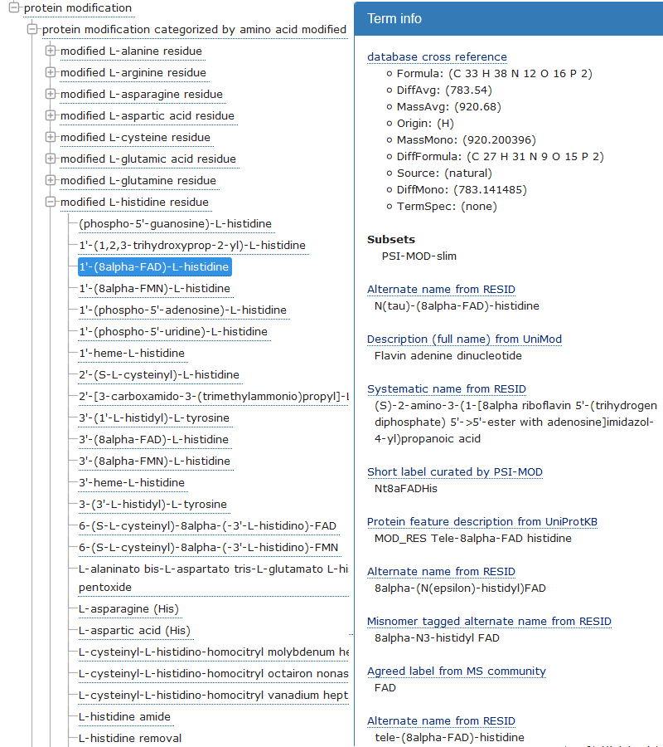
Controlled Vocabularies
Protein Modifications (MOD)
Controlled Vocabulary
URL: https://www.ebi.ac.uk/ols/ontologies/mod
Covers a wide range of modifications:
Functional groups (e.g. phosphorylation, methylation)
Stereochemistry modifications (e.g. D- aminoacids)
Isotope variants
Modifications to protein backbone (eg. cleavage)
Natural and man-made changes
Fluorescent labels
Isotope tags
...
Protein Modifications
Controlled Vocabulary
Notes:
PTMs are covered by MOD – ontology used describe protein modifications. When dealing with interactions involving small molecules another CV – CHEBI (chemical entities of biological interest; also accessible through OLS; > 130k terms !!! ) might be used.

Slide 62
Interaction Records
Issues to be aware of...
Varying level of detail
Most of the experimental methods provide only partial information about interactions
Not all databases record and provide access to all information collected in a given experiment
Possible ambiguities
Identities of the proteins participating in a given interaction might be ambiguous
Experiments often do not reveal spatial relationships between interacting molecules

Slide 63
Interaction Data Resources
Notes:
OLS is not the original source of the CVs – different CV were created and are (or not) maintained by individual people, groups of volunteers, consortia, etc. In some cases, like in case of interaction records, they are components of a two-part solution : record format (typically a file format but it could be also a database schema) specifies how different fields of the record are arranged within a record, CVs provide values to use for some/all fields within a record (Side issue – what is the format for CVs ? OBO - Open Biomedical Ontology; OWL – Web Ontology Language; the split reflects overlap between biomedical informatics and computer science/artificial intelligence/automated reasoning)

Slide 64
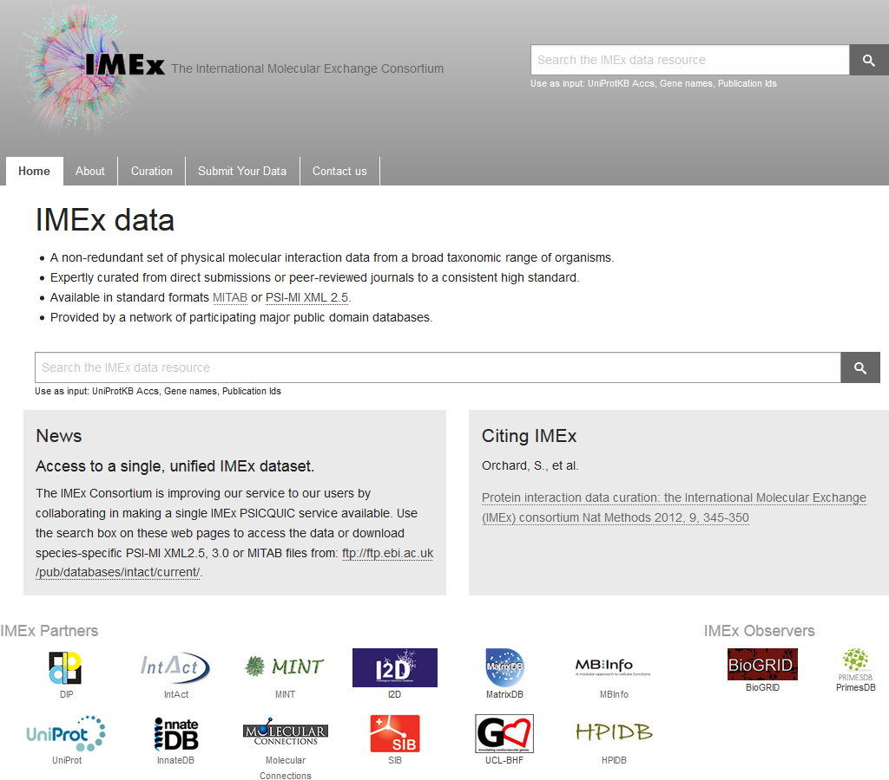
Interaction Data Resources
Primary Data Providers
Detailed (aka ‘IMEx-level’ or ‘deep’) curation
IntAct, EBI (European Bioinformatics Institute), EU
DIP (Database of Interacting Proteins), UCLA
MINT (Molecular INTeractions), U of Rome, Italy
UniprotKB/SwissProt, SIB, Geneva, Switzerland
Lightweight curation
BioGRID
Univerisity of Montreal, Canada
Lunenfeld-Tannenbaun Research Institute, Toronto, Canada
Princeton University
Defunct
BIND
MIPS/MPact
HPRD
MPIDB
...

Slide 65
Interaction Data Resources
IMEx Consortium
Participating databases
Active curation
IntAct, EBI (European Bioinformatics Institute), Hinxton, UK
https://www.ebi.ac.uk/intact
DIP (Database of Interacting Proteins), UCLA
https://dip.doe-mbi.ucla.edu, https://dip.mbi.ucla.edu
MINT (Molecular INTeractions), University of Rome, Italy
https://mint.bio.uniroma2.it/
UniprotKB/SwissProt, SIB, Geneva, Switzerland
https://www.uniprot.org/
Data redistribution
I2D (Interologous Interactions Database), Ontario Cancer Institute, Toronto, Canada
http://ophid.utoronto.ca
InnateDB, Simon Fraser University, Canada, University of British Columbia, Canada, & EMBL Australia
https://www.innatedb.com
MatrixDB , Claude Bernard University Lyon 1, France)
http://matrixdb.univ-lyon1.fr/
....

Slide 66
Interaction Data Resources
IMEx Consortium
Data availability
Interactive
Individual IMEx databases
UniprotKB (‘high quality’ subset)
Dataset downloads
Original (complete) IMEx records
https://www.ebi.ac.uk/intact
Legacy (pre-IMEx) DIP records (as part of Current/Full dataset)
https://dip.mbi.ucla.edu/dip/page?id=download

Slide 67
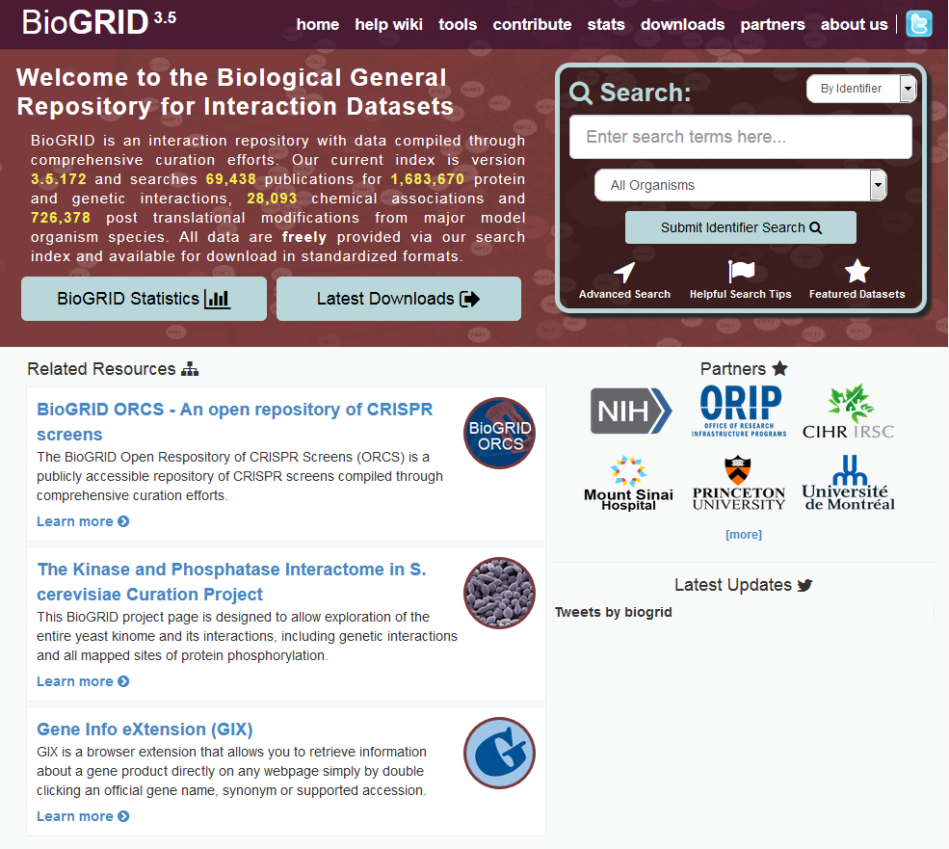
Interaction Data Resources
https://thebiogrid.org
Key Features
Lightweight curation (thus bigger then IMEx)
Pairwise interactions
No information on protein state
No splice form data
No features
No PTMs
Additional interaction types
Genetic interactions
Non-standard (tabular) data format
Simplified controlled vocabulary

Slide 68
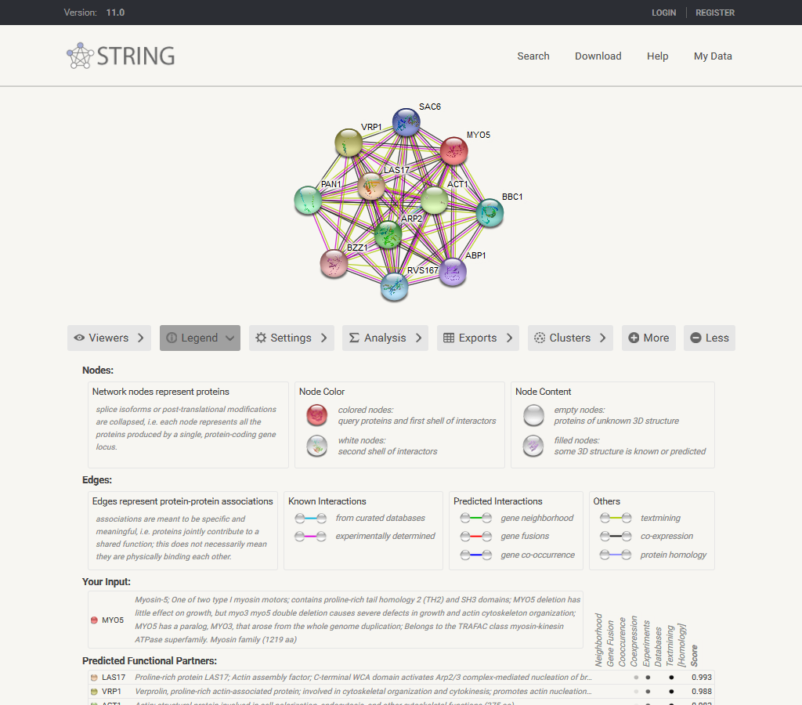
Interaction Data Resources
Integrators
Interaction resources
STRING
GeneMania
HIPPIE
HINT
APID
...
General resources
UniprotKB
Reactome
Defunct
iRef database/iRefIndex
MiMI database
...
Notes:
Title

Slide 69
Interaction Data Resources
Key Features
Identifies pairwise functional associations between genes
Only gene level information
Functional associations include:
Computational predictions (in house)
Co-occurrence in genomes
Genome neighborhood
Gene fusion (Rosetta Stone)
Text Mining
Co-occurrence in publications
Molecular interactions
IMEx Consortium
BioGRID
... and others
Pathway information
Rectome
KEGG
BioCyc
... and others
Co-expression
https://string-db.org
Operational definition: genes that function within the same pathway or module.
Notes:
Title

Slide 70
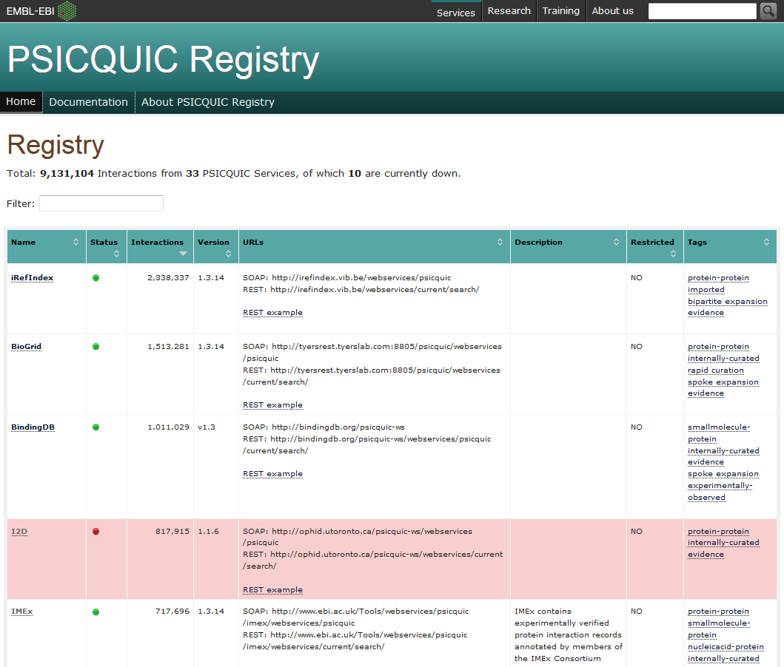
Interaction Data Resources
PSI Common Query Interface (PSICQUIC) Servers
Registry: https://www.ebi.ac.uk/Tools/webservices/psicquic/registry/registry?action=STATUS
Programmatic access to interaction data
SOAP & REST APIs
Results returned as PSI-MI, MITAB, etc
MIQL Queries
(brca1 or brca2) and species:human
(atpa_yeast or atpb_yeast) and type:”physical association”
References
https://psicquic.github.io/MiqlDefinition.html
Aranda et al. PSICQUIC and PSISCORE: accessing and scoring molecular interactions.
Nat Methods. 8:528-9 (2011) PMID:21716279
Nucleic Acids Res. del-Toro et al. A new reference implementation of the PSICQUIC web service.
NAR 41:W601-606 (2013) PMID:2367134
Notes:
Title

Slide 71
Interaction Experiments: Examples
Heterologous expression (human proteins/insect cell expression)
In vitro complex reconstitution
Cryo-EM structure determination
Alternative conformational states
PDB: 5LCW
Alfieri et al. Nature 536:431-436 (2016); PMID: 27509861
Notes:
APC: Human proteins co-expressed in insect cells (hi5), Apc4 StrepII-tagged. MCC (Cdc20, Mad2, BubR1, Bub3): Human proteins co-expressed in insect cells, 3xFLAG BubR1; lysates mixed, complexes purified by sequential affinity steps. 4.2A final resolution (alternative, less populated conformational states at 4.8-89A)
In practice, structure determination is, due to technical reasons, rather rate. The key factors is that most structure determination methods require large (mg) amounts of pure proteins. However, the same methods that are used, on preparative scale, to purify large amounts of complexes for structural studies can be used to demonstrate interactions when utilized on analytical scale.

Slide 72
Interaction Experiments: Examples
Heterologous protein expression (insect cells)
In vitro complex reconstitution
Size exclusion chromatography of the final purified complex
Size Exclusion Chromatography
Alfieri et al. Nature 536:431-436 (2016); PMID: 27509861
Notes:
If needed, proteins might have been identified by Western blot, LS-MS/MS of individual bands, N-terminal sequencing (Edman degradation) of individual bands.
The overlapping shapes of the elution profiles of individual components might suggest that there is just one physical complex; stoichiometry might be hard to evaluate, small components might be overlooked, contaminating proteins might be present.
Need to mention MS of native complexes somewhere!!!!

Slide 73
Interaction Types
B
Notes:
Ideally, experiment would provide complete information about spatial relationship between individual protein molecules. This is no always the case – only a small fraction of experiments let us infer which protein molecules within a protein complex are in direct contact or connect through covalent bonds. In most of the cases only partial inferences can be drawn. The types are assigned in such way that it is possible to consistently assign interaction type to binary interactions derived from interactions between multiple proteins.

Slide 74
Interaction Experiments: Methods
Chromatography/Co-purification
Size Exclusion Chromatography
Notes:
If needed, proteins might have been identified by Western blot, LS-MS/MS of individual bands, N-terminal sequencing (Edman degradation) of individual bands.
The overlapping shapes of the elution profiles of individual components might suggest that there is just one physical complex; stoichiometry might be hard to evaluate, small components might be overlooked, contaminating proteins might be present.
Need to mention MS of native complexes somewhere!!!!

Slide 75
Interaction Experiments: Strategies
Structure determination
Copurification
Solid phase assays
Biochemical/biophysical property perturbation
Structural methods
Crystallography and Structure Determination Core
https://www.doe-mbi.ucla.edu/x-ray-crystallography-core-technology-center/
Biosciences NMR Core Facility
https://www.doe-mbi.ucla.edu/ucla-doe-biosciences-nmr-core-facility/
M230B/M230D: Winter quarter
principles of X-ray crystallography, cryo-EM and NMR
Lecture and hands-on lab
Non-registered participants OK
Advantages
Cheap/Fast
Amenable to high-throughput approaches
Disadvantages
Often only partial information:
Missing components
No stoichiometry
No contacts
Might miss weak/transient interactions
Advantages
May provide very detailed information about one particular interaction
May be customized to address one particular question about interaction
Disadvantages
Might be slow and/or not amenable to high throughput approaches
Might require specialized equipment
Notes:
Small fraction of complexes (~20%) existed in two other conformational states that could have been identified and their structure determined (4-8A resolution)

Slide 76
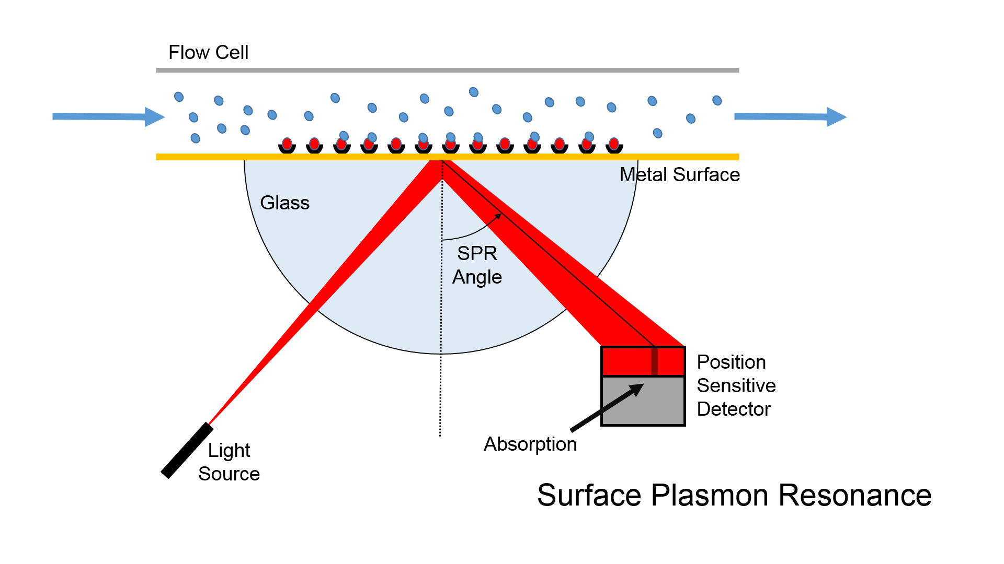
Interaction Experiments: Methods
Solid State Assays
Notes:
Chromatography methods exploit interactions to isolate individual protein complexes. They are analyzed later on, after elution from the chromatographic column. Complementary methods characterize protein-protein interactions by monitoring formation of the interaction complexes directly on the solid support. These include Far Western blot, ELISA, peptide arrays, surface plasmon resonance and a slew of other methods.

Slide 77
Interaction Experiments: Example
Chromatography/Co-purification
Overexpression (human) of doubly-tagged (FLAG & HA) human H2A, H2A.Z & ANP32E proteins
Tandem affinity purification of interacting partners
Mass spectrometric and/or Western blot protein identification
MS
Western
Affinity Chromatography
Obri et al. Nature 505:648-53 (2014); PMID: 24463511
Notes:
As before, proteins may be identified by Western blot, LS-MS/MS of individual bands, N-terminal sequencing (Edman degradation) of individual bands. Presence of predetermined components may be confirmed by non-specific staining (eg Coomassie). Affinity based methods DO NOT GUARANTEE that all the proteins are components of the same complex.

Slide 78

Interaction Experiments: Methods
Immobilized CNGA3
CDH23 (+68)
Purified fragment (1-149; His-tagged) of rat CNGA3 expressed in E. coli
Purified rat CDH23 (+/- exon68; His-tagged) expressed in E. coli
CDH23 (-68)
buffer
Bind
Wash
CDH23 (+68)
Surface Plasmon Resonance
Selvakumar et al. JBC 288:7215-7229 (2014); PMID: 23329832
Notes:
Chromatography methods utilize interactions to isolate individual protein complexes. The complexes are analyzed later on, after elution from the chromatographic column. Complementary methods characterize protein-protein interactions by monitoring formation of the interaction complexes directly on the solid support. These include Far Western blot, ELISA, peptide arrays, surface plasmon resonance and related methods and a slew of other methods.

Slide 79
Interaction Experiments: Methods
Immobilized CNGA3
CDH23 (+68)
Purified fragment (1-149; His-tagged) of rat CNGA3 expressed in E. coli
Purified rat CDH23 (+/- exon68; His-tagged) expressed in E. coli
CDH23 (-68)
buffer
Bind
Wash
CDH23 (+68)
Surface Plasmon Resonance
Selvakumar et al. JBC 288:7215-7229 (2014); PMID: 23329832
Notes:
Chromatography methods utilize interactions to isolate individual protein complexes. The complexes are analyzed later on, after elution from the chromatographic column. Complementary methods characterize protein-protein interactions by monitoring formation of the interaction complexes directly on the solid support. These include Far Western blot, ELISA, peptide arrays, surface plasmon resonance and related methods and a slew of other methods.

Slide 80
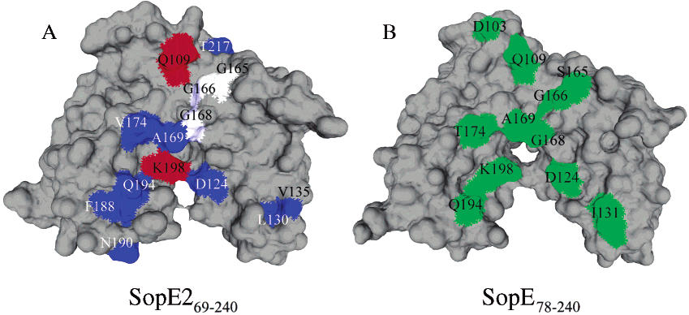
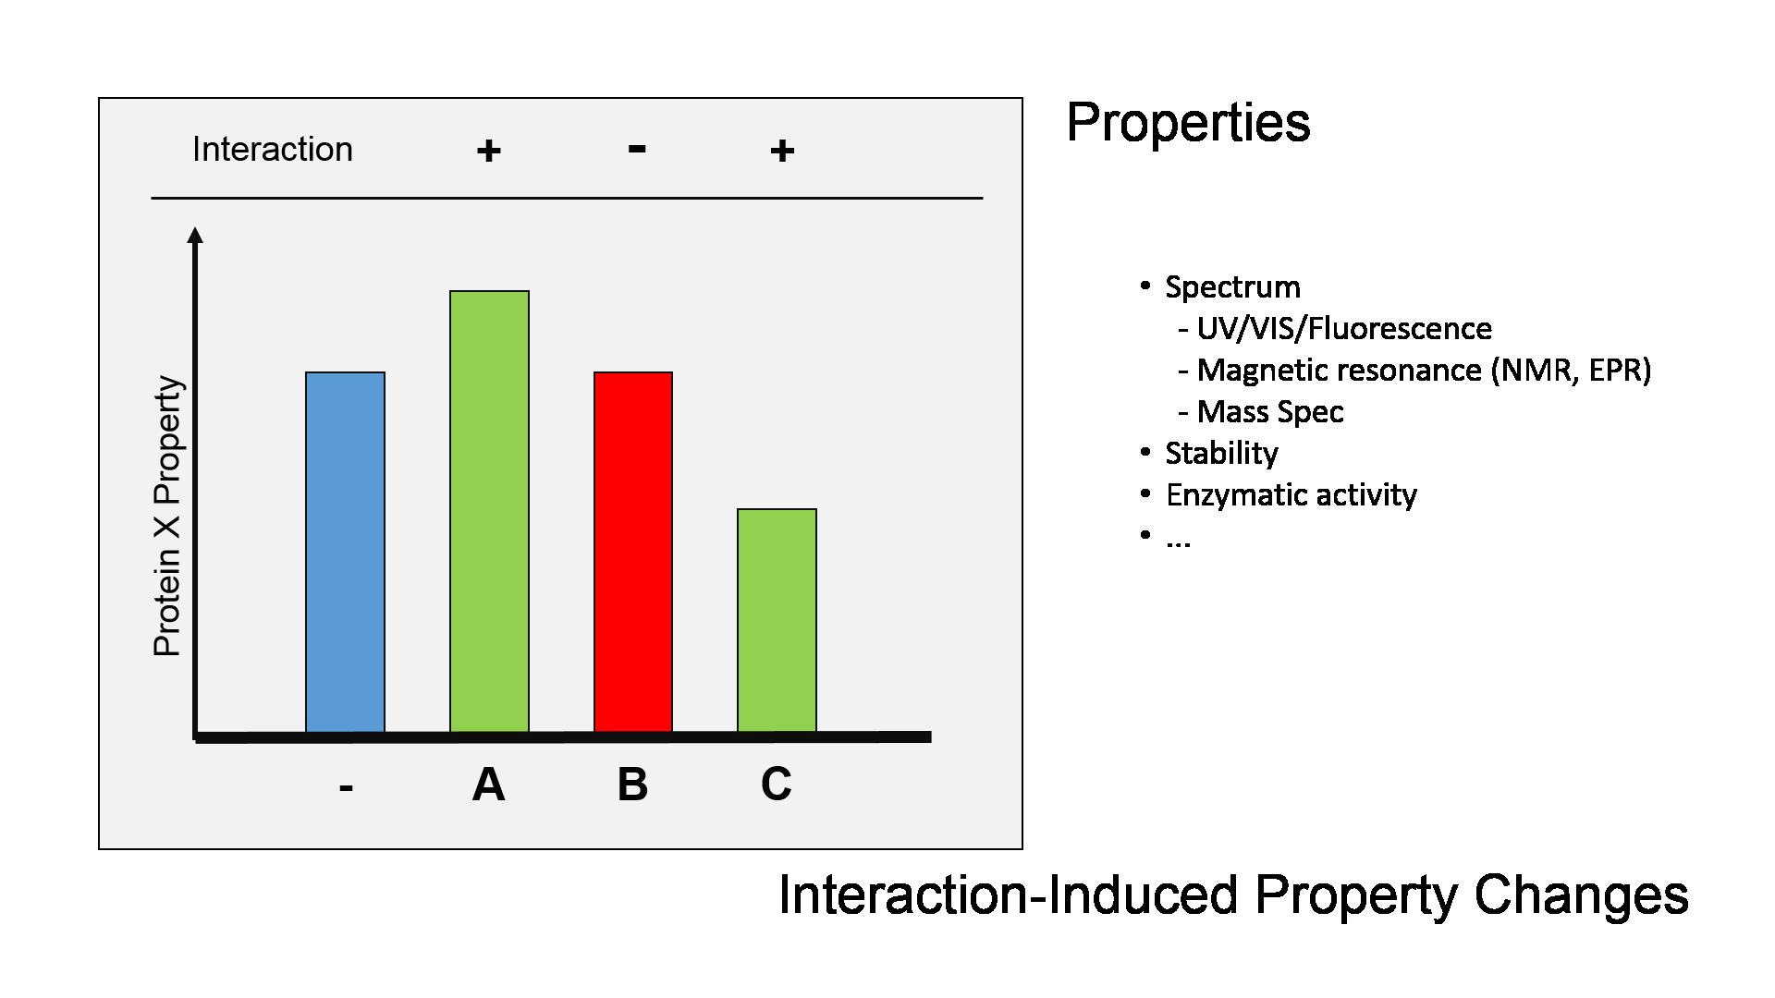
Interaction Experiments: Examples
NMR
Heterologous (E. coli) expression of Salmonella (SopE2) and human (Cdc42) protein fragments
In vitro complex formation by purified proteins
Monitor perturbation of SopE2 NMR spectra by Cdc42 protein
X-ray
Interaction-Induced Property Change
Williams et al. Biochem. 43:11990-1008 (2004); PMID: 15379540
Notes:
Complexes of interacting proteins do not have to be physically isolated in order to demonstrate that proteins interact. In some cases isolation of od such complexes might be very hard (eg enzyme-substrate pairs, such as protein kinase or phosphatase and their corresponding targets). However, it is often possible to observe and possibly quantitate the effect of a protein on its interaction partner without the need to explicitly isolate the interacting pair.

Slide 81
Interaction Experiments: Examples
Electron density
Native (chicken) complex purified from heart mitochondria
Structure determined by X-ray crystallography to 3.0A
9 (out of 11) subunits identified/localized, at least partially, within the structure
PDB: 1BCC
Zhang et al. Nature 392:677-684(1998); PMID: 9565029
Notes:
Chicken mitochondrial bc1 complex at 3.0A resolution. Historically, high resolution crystal structures (including structures of interacting proteins (vide heamoglobin) precede cryo-EM structures. In both cases structures of natively expressed protein complexes are relatively rare – in most of the cases modification of expressed protein sequence and/or expression level and host are required in order to ensure sufficient enough sample quality.

Slide 82
Interaction Database Records
Formats
Notes:
OLS is not the original source of the CVs – different CV were created and are (or not) maintained by individual people, groups of volunteers, consortia, etc. In some cases, like in case of interaction records, they are components of a two-part solution : record format (typically a file format but it could be also a database schema) specifies how different fields of the record are arranged within a record, CVs provide values to use for some/all fields within a record (Side issue – what is the format for CVs ? OBO - Open Biomedical Ontology; OWL – Web Ontology Language; the split reflects overlap between biomedical informatics and computer science/artificial intelligence/automated reasoning)

Slide 83
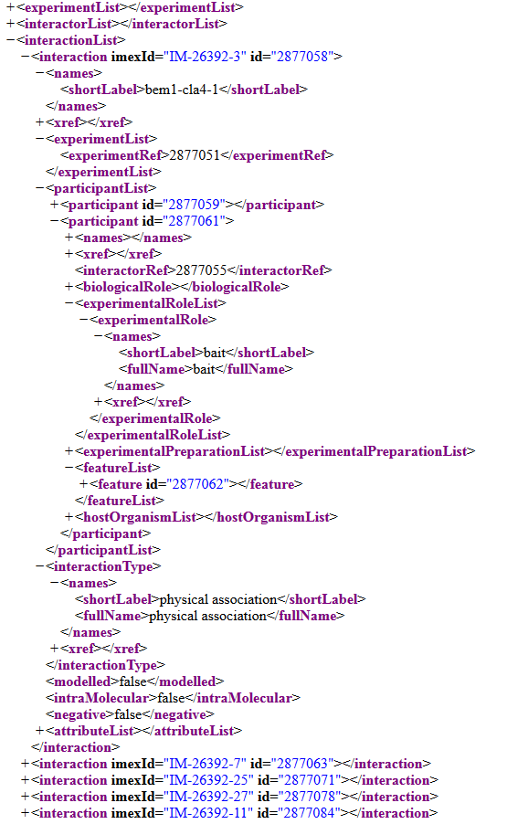
Interaction Record Formats
PSI-MI XML (MIF) format
Interaction Record
Interaction Experiment
Interaction Detection Method: Pull down (MI:0096)
Experiment Host/Cell Line: in vitro
Interaction Type: Direct (MI:0407)
Participant List
1
2
Molecule Type: Protein (MI:0326)
Molecule Name: Cellular tumor antigen p53
Molecule Symbol: p53
Species of Origin: Human (Taxid:9606)
Cross-reference(s): P04637-1 (UniProtKB), NP_00537, (RefSeq), …
…
N
Experimental Role: Bait (MI:0496)
Experimental Source: E.coli K12 (Taxid: 83333)
Identification method(s): Predetermined (MI:0396)
Features:
1
2
Feature Type: Sufficient binding region (MI:0442)
Feature Range: 1-73
Identification Method: Deletion analysis (MI:0033)
…
M
Notes:
Title

Slide 84
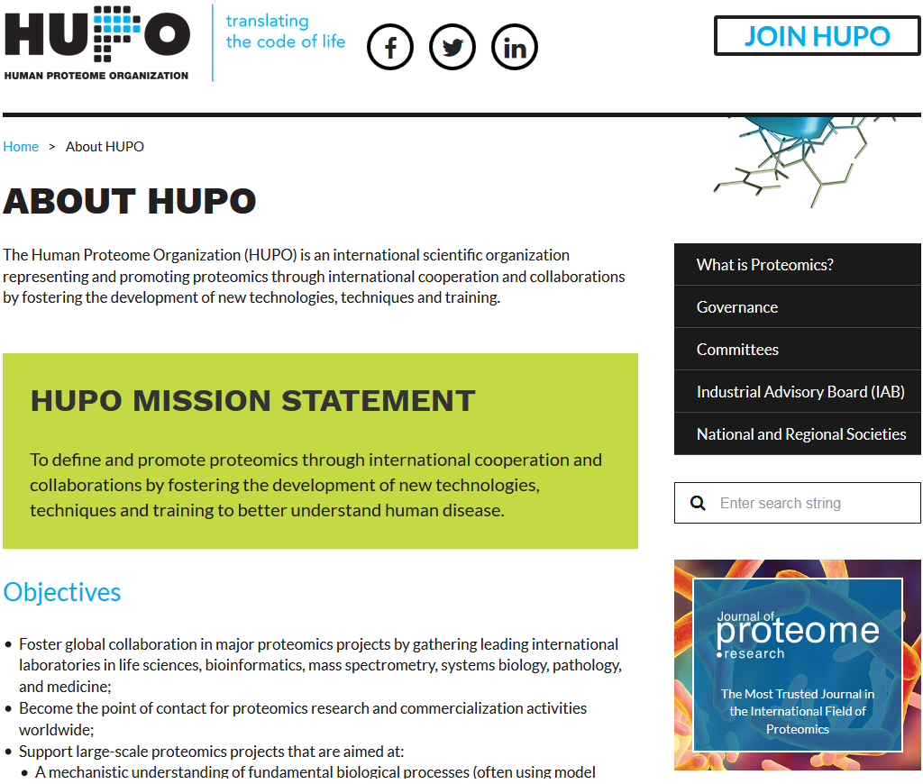
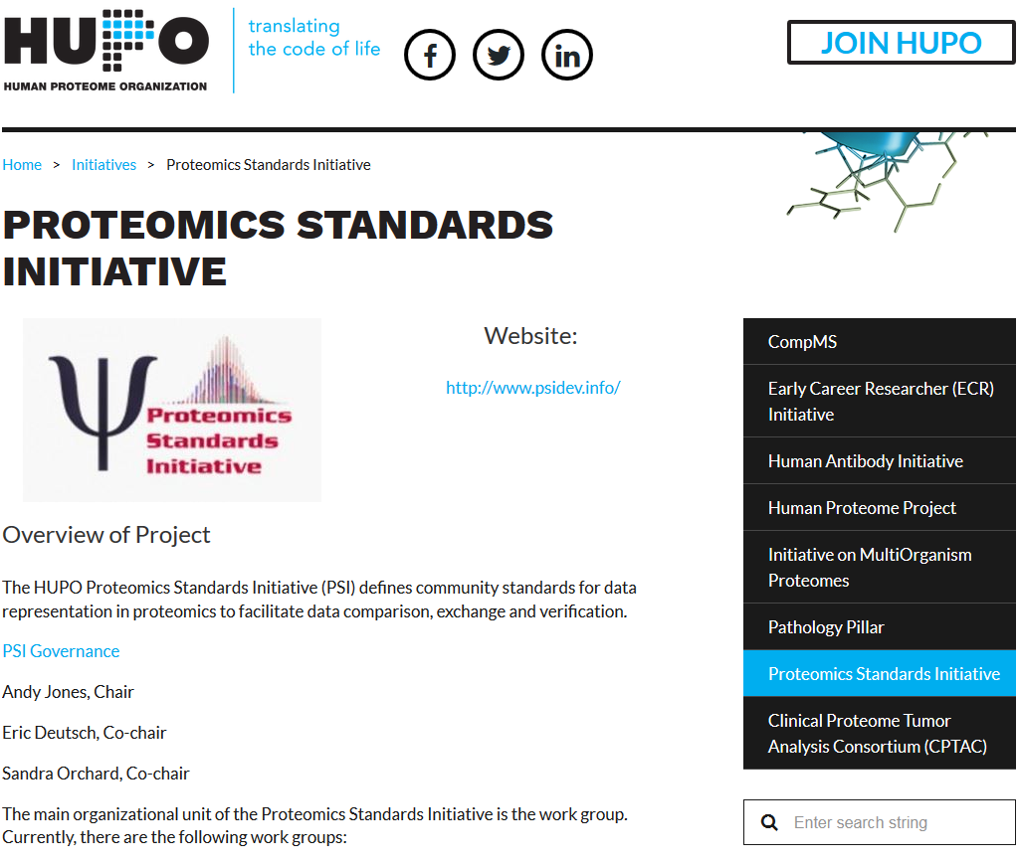
MIF/MI Definitions
Notes:
Title

Slide 85
Interaction Record Formats
PSI-MI XML (MIF) format
Good
Bad
Stable
MIF 2.5 (2007)
MIF 3.0 (2018; mostly backward-compatible)
Database-neutral
Developed by HUPO-PSI
Widely used by data providers
IMEx Consortium (DIP, IntAct, MINT,...) – native
BioGRID – export
Expressive enough to describe most of the interaction experiments
Multi-protein interactions
Protein features (PTMs, mutations, ...)
Multiple experimental methods/protein
Not limited to proteins
Nucleic Acids
Small Molecules
Overly verbose
Redundant open/close tags
Several levels of nested elements
But compresses quite well – 20x is not that rare
Does not fit ‘Excel spreadsheet’ paradigm
Not too surprising – interaction data is NOT tabular
Limited set of good quality user-side tools
Java JAMI is very versatile but complicated
Limited support for reporting experiment ambiguities
MIF 3.0 provides some support but curation lags
No support for oligo-/poly-saccharides
Limited by the current state of nomenclature
No active curation (to my knowledge)
XML is considered to be hard to work with
Notes:
Title

Slide 86
Interaction Record Formats
PSI-MI tab-delimited (MITAB) format
Good
Bad
Applicable only to binary interactions
Cannot handle multi-protein complexes
Many columns can be multi-valued
Requires custom parsing routines
Some information originally available in MIF format cannot be stored as MITAB
The format is lossy – is, essentially, impossible, to restore fully-featured MIF record from its MITAB representation
Less stable than MIF
MITAB 2.5, 2.7, 2.8 (MIF 2.5 derivatives)
MITAB 3.0 (3.0 derivative)
Easy to read into a spreadsheet
Supported by third-party libraries
Notes:
Title

Slide 87
Interaction Record Formats
BioGRID tab & complex tab formats
Good
Bad
Separate format for binary and multi-protein complexes
Supports only protein-protein interactions
Identifies proteins by gene identifies
It works only for organisms that do not splice
Provides less information than PSI-MI MIF
This is because BioGRID extracts less information about interactions that IMEx Consortium databases
Uses simplified, non-standard CV terms
See also MITAB deficiencies
Easy to read into a spreadsheet
Notes:
Title

Slide 88
Interaction Record Formats
Cytoscape SIF format
Good
Bad
Native Cytoscape format
Simple/easy to prepare (spreadsheet will work)
Not limited to biological data
Only binary interactions
Must be combined with information from additional files in order to provide more detailed information
SIF
Interaction Type (arbitrary)
Molecule name (arbitrary)
Molecule Property File
Molecule Name
Property
MoleculeA pp MoleculeB
MoleculeA pp MoleculeB1 MoleculeB2 MoleculeB3
...
Interaction Property File
Interaction Name
Property
MoleculeA = Value1
MoleculeB = Value2
...
MoleculeA (pp) MoleculeB1 = Value1
MoleculeA (pp) MoleculeB2 = Value2
...

